Slide 1
Views In PowerPoint
MOAC Lesson 1

Slide 2
Views
The ways in which presentation content can be displayed onscreen, such as Normal view, Slide Sorter View, or Slide Show View (John Wiley & Sons, Inc., 2014)

Slide 3
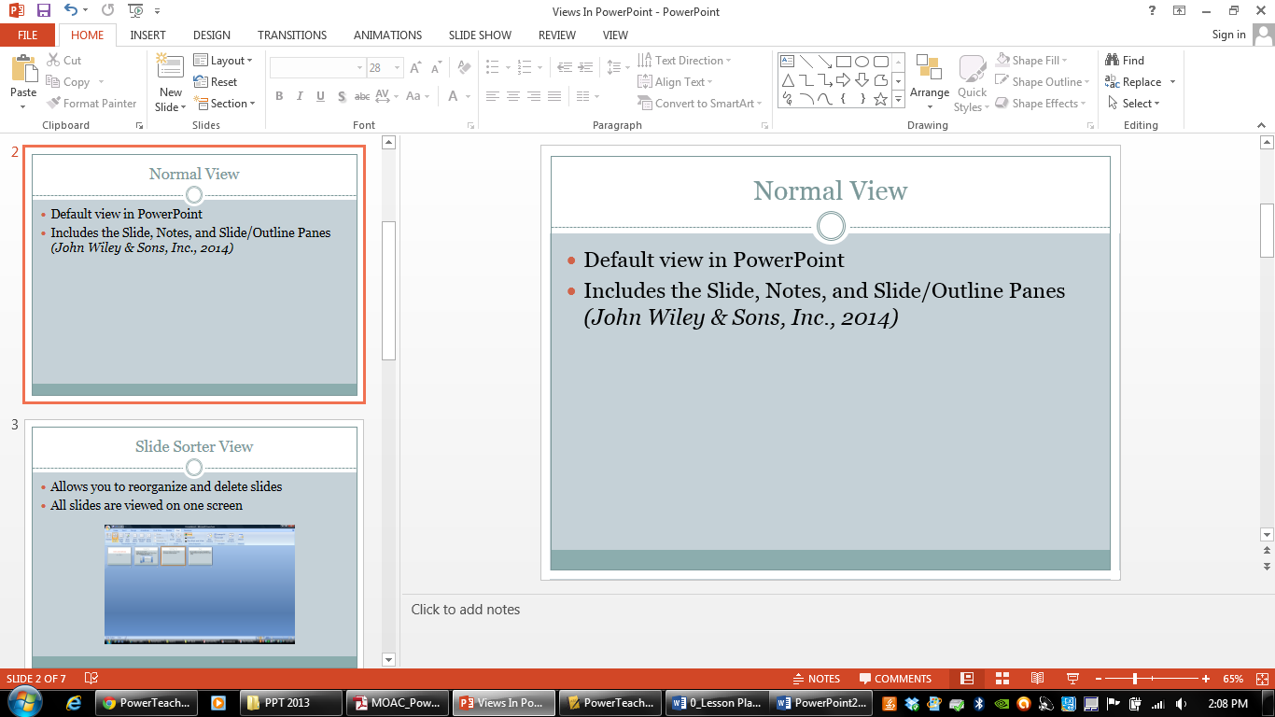
Normal View
Default view in PowerPoint
Includes the Slide, Notes, and Slide Panes (John Wiley & Sons, Inc., 2014)

Slide 4
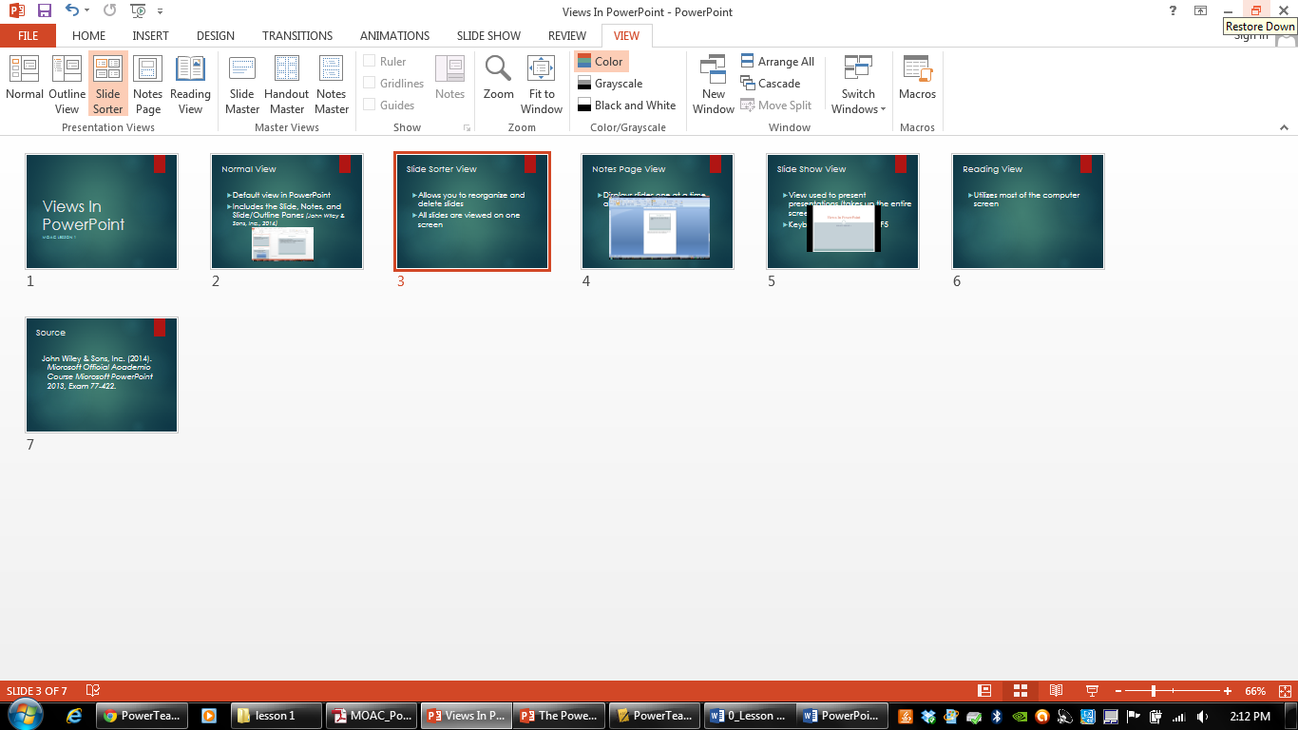
Slide Sorter View
Allows you to reorganize and delete slides
All slides are viewed on one screen

Slide 5
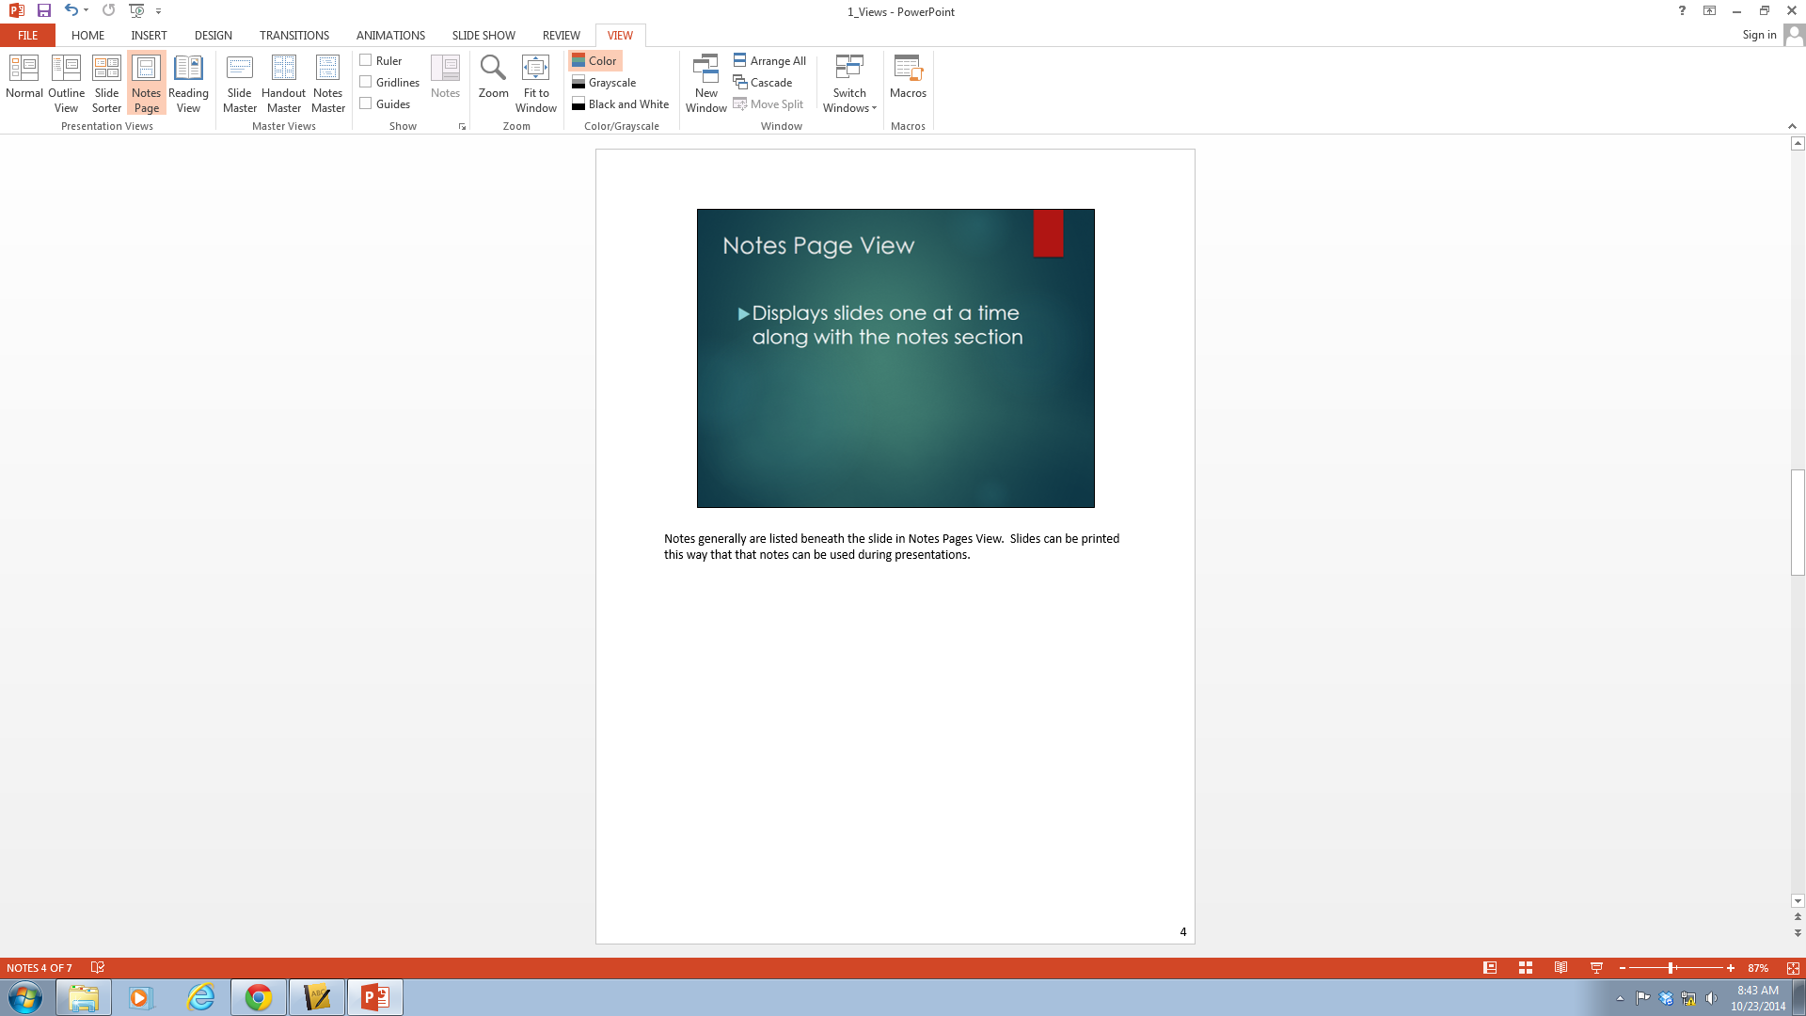
Notes Page View
Displays slides one at a time along with the notes section
Notes:
Notes generally are listed beneath the slide in Notes Pages View. Slides can be printed this way that that notes can be used during presentations.

Slide 6
Slide Show View
View used to present presentations (takes up the entire screen)
Keyboard shortcut key is F5

Slide 7
Reading View
A view like Slide Show view that allows the user to preview a presentation on the screen except it’s in a window rather than filling the entire screen (John Wiley & Sons, Inc., 2014)

Slide 8
Source
John Wiley & Sons, Inc. (2014). Microsoft Official Academic Course Microsoft PowerPoint 2013, Exam 77-422.

