Slide 1
Week 3
Software

Slide 2
Your Instructors
Ms. Blount
Mr. Lile
Mr. Marshall

Slide 3
Last week: Connections and Troubleshooting
Peripherals connect to a computer and provide input and output
Use troubleshooting steps to figure out how to fix computer problems
Triage is Kramden’s process for refurbishing, or fixing up, computers

Slide 4
BIO Stations

Slide 5
This week: Software
You’ll learn how a computer encodes and decodes data to process and store it
You’ll learn that Software includes Operating Systems and Programs (Apps)
You’ll learn about different Operating Systems
You’ll load an operating system on the computers you worked on last week

Slide 6
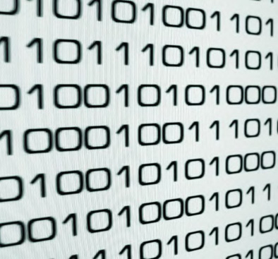
Computers Think in Binary
Computers think with only two numbers: ONE or ZERO. This is called binary code.
You can also think of it like a light switch being ON or OFF.
Each one or zero is called a Binary Digit, or Bit.

Slide 7
Data is the Bits Your Computer Uses
Data is all the bits you send or receive from a computer.
A file is data you save on the hard drive. It has been turned into bits by the computer.

Slide 8
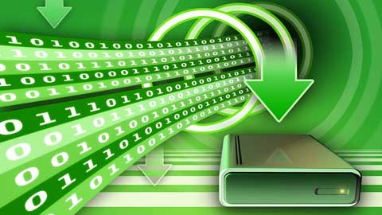
Encoding
Humans don’t think in binary code. We use more than 2 numbers and letters.
All the information we input to a computer has to be converted to binary. This is called encoding.
Every input a computer receives is encoded into bits.

Slide 9
Decoding
The encoded data is processed by the CPU.
The CPU keeps it in binary until it needs to be output back to a human.
When that data is ready to be output, it’s decoded back to something a human can read. Then it’s displayed or printed.

Slide 10
When You Type a Letter on the Keyboard...
Encoding and decoding happens all the time, like when you type a letter on the keyboard.
The input is when you press a key. The letter is encoded to binary.
The output is when the letter is displayed on the monitor. The letter is decoded from binary back to an alphabet letter.

Slide 11
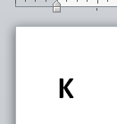
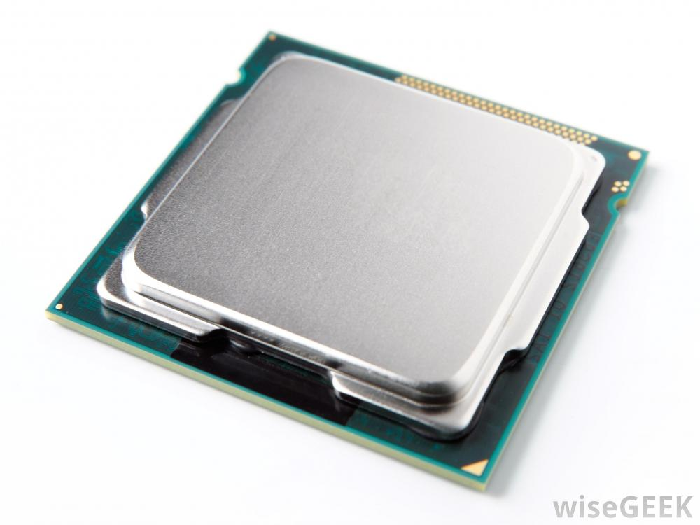
When You Type a Letter on the Keyboard...
Input:
Press a letter key
Encode:
Convert letter to binary
Process:
CPU sends bits to program
Decode:
Convert binary to letter
Output:
Letter displayed on screen

Slide 12
Let’s Try Encoding and Decoding Data
We’re going to try some encoding and decoding so you can see how a computer thinks. Keep in mind that it may take you a minute to encode or decode a letter, but a computer can do it billions of times a second.

Slide 13
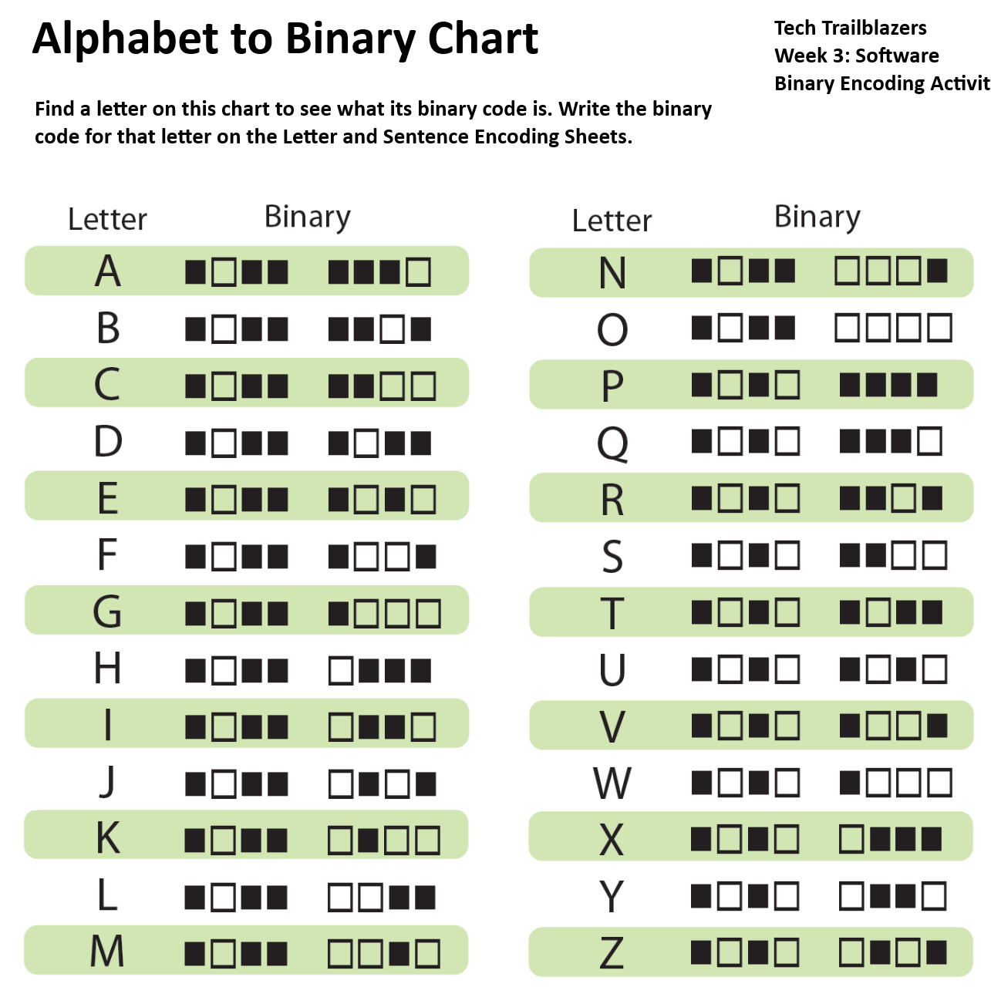
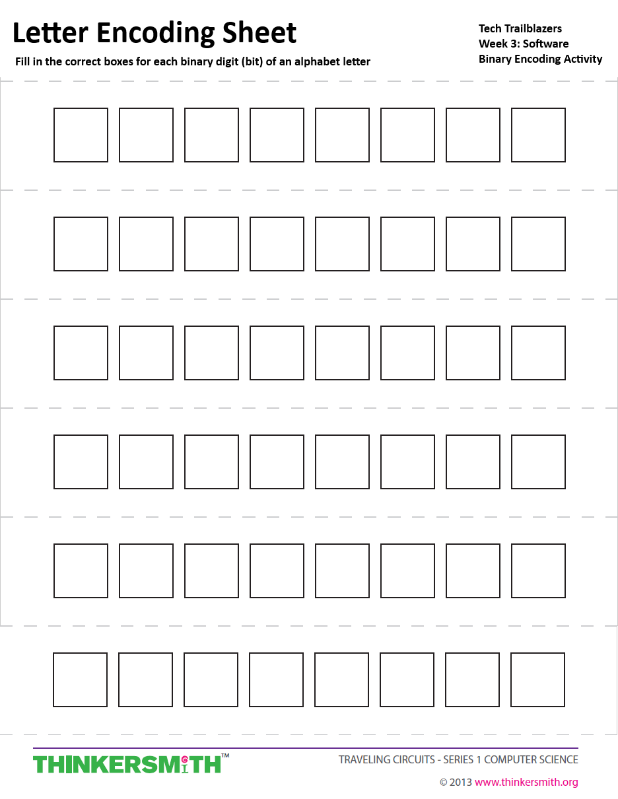
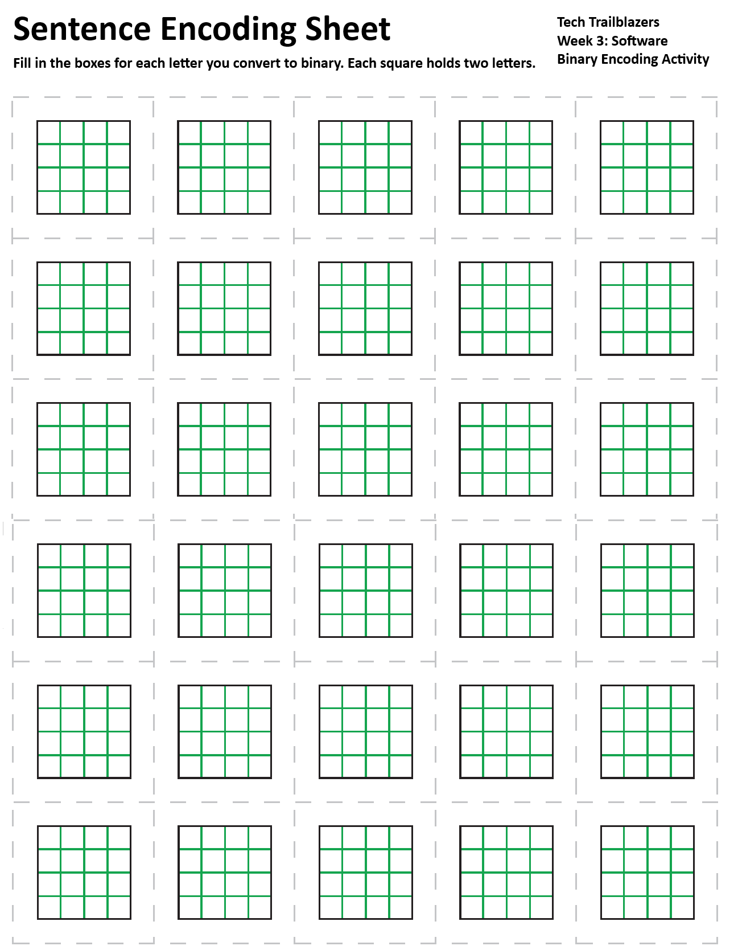
Pick up a Data Packet (3 sheets)
Alphabet Chart
Letter Encoding Sheet
Sentence Encoding Sheet

Slide 14
Letters Encode into Patterns of Bits
When a computer encodes a letter into binary, it follows a standard pattern called ASCII that gives each letter a series of ones or zeroes.
Each letter is 8 bits long and has a unique pattern so the computer can tell the letters apart.
A series of 8 bits is also called a byte.
Byte
=
Bit

Slide 15
Letters Encode into Patterns of Bits
The Alphabet in Binary chart shows you the bits that make up each letter.
There are 8 boxes, one for each bit that make up the letter
On the chart, a black box is a 1 and a empty box is a 0.
= 0
= 1

Slide 16
Look up “K” on the chart.
The binary encoding for the letter K is:
1 0 1 1 0 1 0 0

Slide 17
What’s the code for Ms. B’s initials?
Listen and watch as Ms. B encodes her initials.
R
B

Slide 18
What’s the code for Ms. B’s initials?
Listen and watch as Ms. B encodes her initials.
R
B

Slide 19
What’s the code for Ms. B’s initials?
Listen and watch as Ms. B encodes her initials.
R
B

Slide 20
Now encode your initials!
Use the Alphabet In Binary Chart to look up your first initial. Fill in the boxes on the first line of the Letter Encoding Sheet to match the chart.
Letter Encoding Sheet:

Slide 21
Now encode your initials!
Now encode your second initial by filling in the boxes on the second line.
Letter Encoding Sheet:

Slide 22
Pass your Letter Encoding Sheet to your neighbor.
Now you’re going to decode your neighbor’s initials!
Letter Encoding Sheet:

Slide 23
Decode your neighbor’s initials
Use the chart to match the patterns and find the correct letter. Write the letter on the Letter Encoding Sheet. Now you’ve decoded their initials.
R
B

Slide 24
Coded Messages
In teams of two, go to a computer station with your Data Packet sheets.
Each team gets a secret message to encode.

Slide 25
Decode this word:
Keep your answer secret until everyone’s done!

Slide 26
Decode this word:
B
I
N
A
R
Y
= B I N A R Y

Slide 27
Encoding a Long Message
For this secret message, use the Sentence Encoding Sheet. Put two encoded letters in each square. Use as many squares as you need.
Use 8 blank boxes for a SPACE character.

Slide 28
Pass your Encoded Message to another team
Make sure to write your names on the sheet!
Ms. B

Slide 29
Decode the other team’s Secret Message
Write down the letters underneath each square.
B I N A R Y <space><space> <space><space>

Slide 30
Compare the original message to the decoded message
Were there any differences? Were all the letters encoded and decoded correctly?
When computer data is bad, it’s called corrupted.

Slide 31
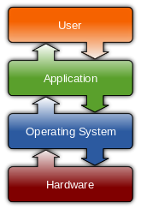
What is Software?
Software is binary code saved on the computer.
It gives the computer instructions. It uses the CPU, internal components, and input and output peripherals to accomplish a task.
There are two main types of software: the operating systems (OS) and application programs.

Slide 32
What is Software?
Software uses the hardware to run.
Different types of software run in order:
User
Program
Program
Program
Operating System
BIOS
Computer Hardware

Slide 33
What is an Operating System?
Operating systems are complex pieces of software that supports a computer's basic functions, like drawing windows on the monitor, saving files, running programs, and controlling peripherals.
OSes are big and complex and take a lot of work to create. So there are only a few OSes that are widely used.

Slide 34
What operating systems have you have heard of?

Slide 35
What operating systems have you have heard of?
Windows
Mac OS
Linux
iOS, Android, Chrome OS

Slide 36
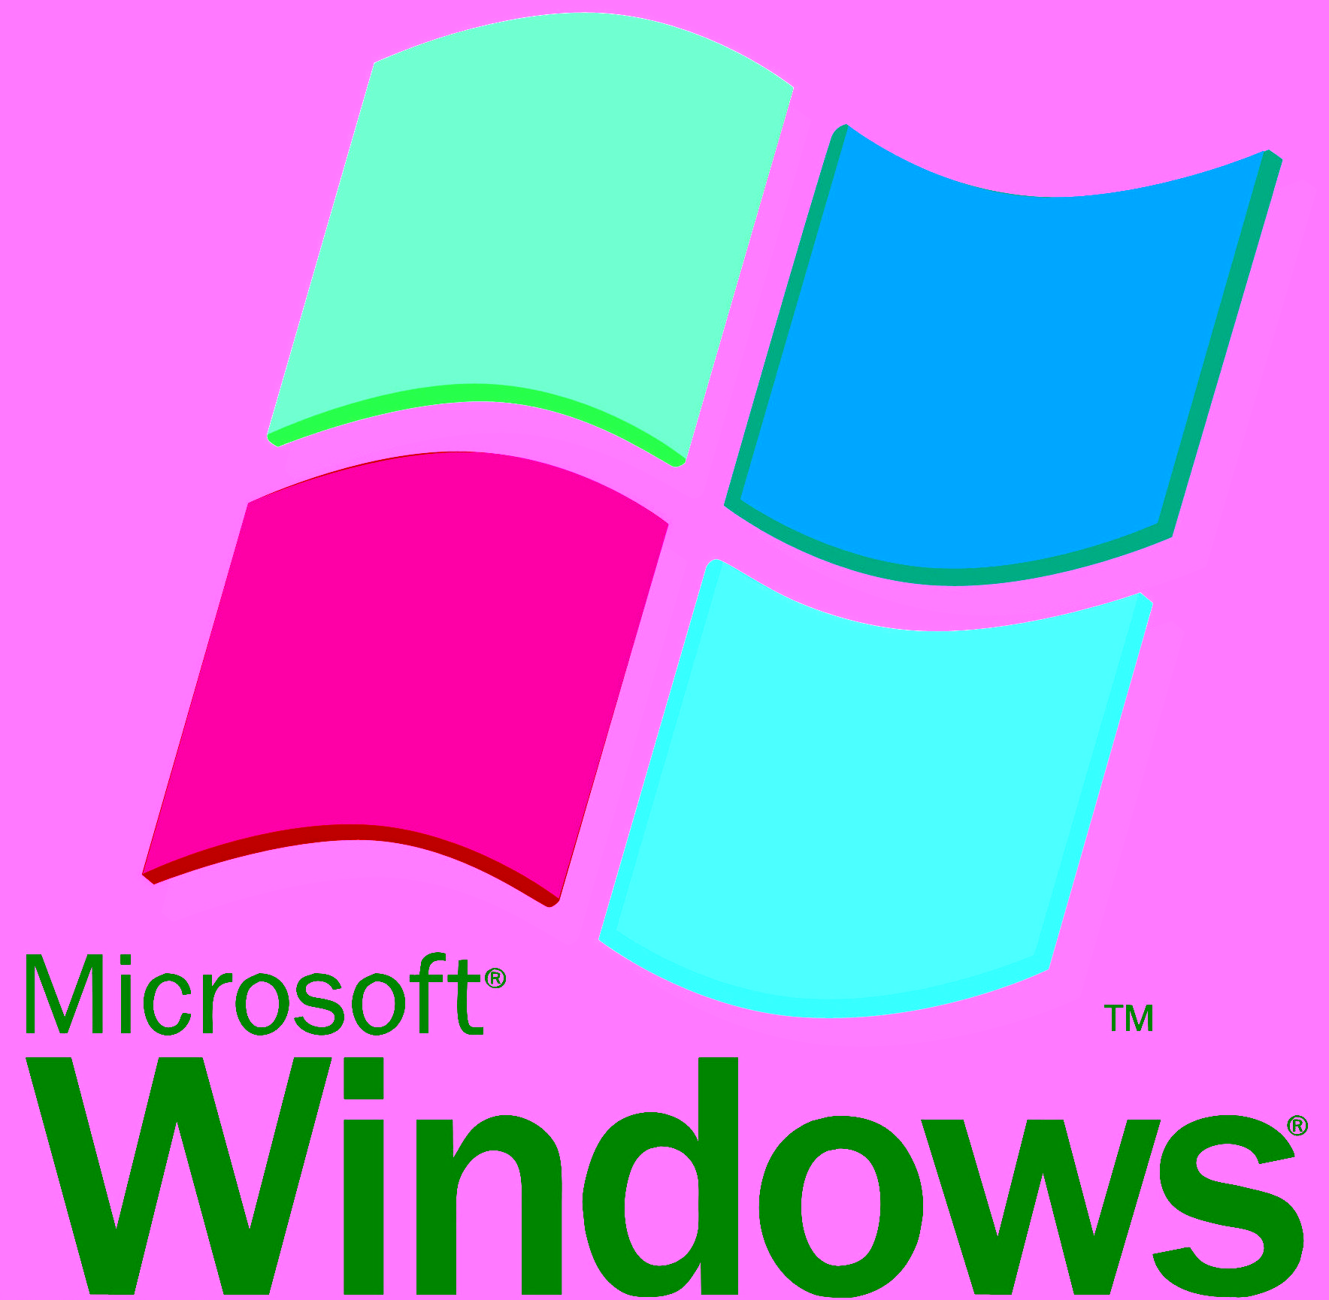
Microsoft Windows
Windows is a very common and popular OS. It was first released in 1985.
About 85% of desktop computers use Windows. It runs on computers made by many different companies, like Dell and HP.
It costs about $100, but it’s included in the price of most new computers.

Slide 37
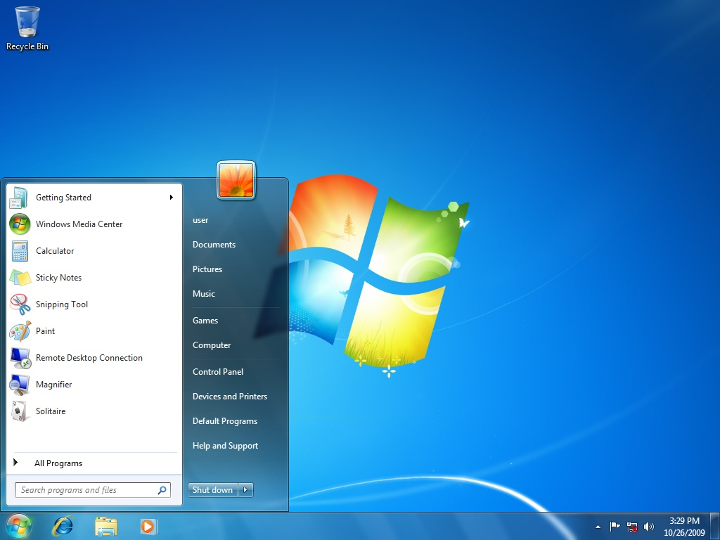
Microsoft Windows

Slide 38
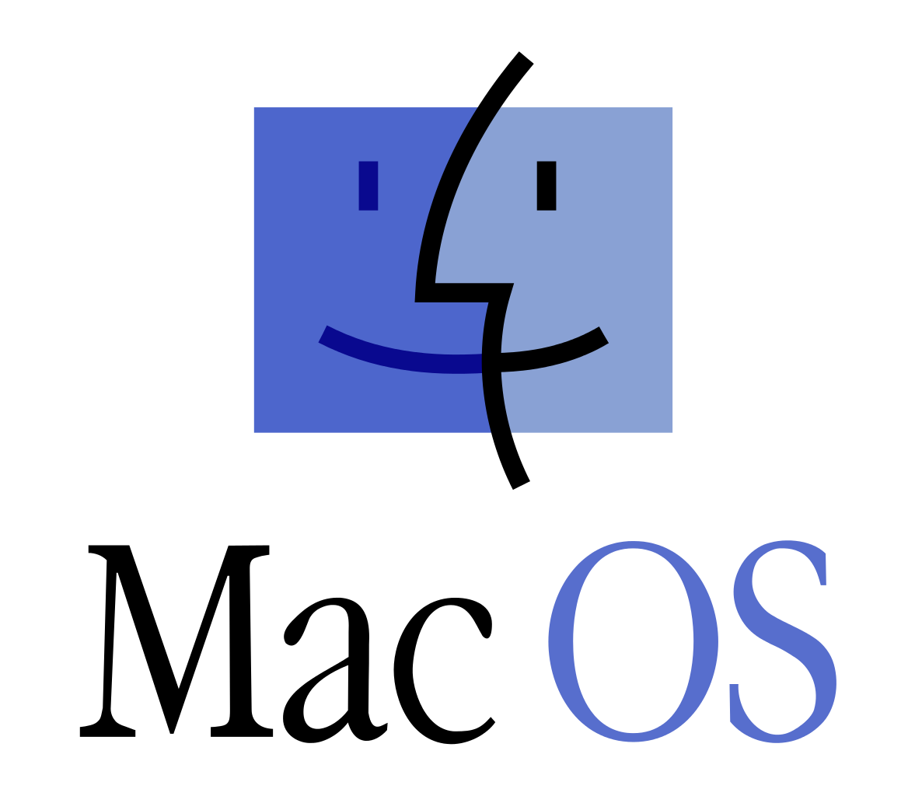
Apple Mac OS
Mac OS is only for computers made by Apple. Mac OS was first released in 1984.
It’s used by a lot of people for creative jobs.
About 10% of computers run Mac OS.
Mac OS comes with every Apple computer, so it’s always built in to the computer’s price.

Slide 39
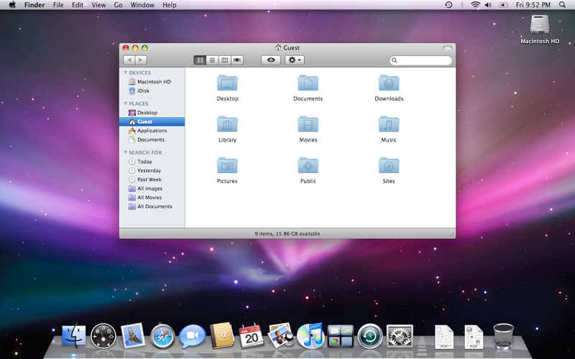
Apple Mac OS

Slide 40
Linux
Linux is a free and open-source OS. Linux is free to download and use and it runs on computers from all different companies. It will run on almost every computer.
About 5% of computers run Linux.
About 95% of Internet server computers on use Linux.

Slide 41
Linux
It’s developed by programmers around the world who add to and fix bugs in Linux and then share with everyone else. Anyone can see the software source code that makes up Linux.
This is like sharing your secret messages and the alphabet chart with everyone so they can see what you’re doing and how it’s done.

Slide 42
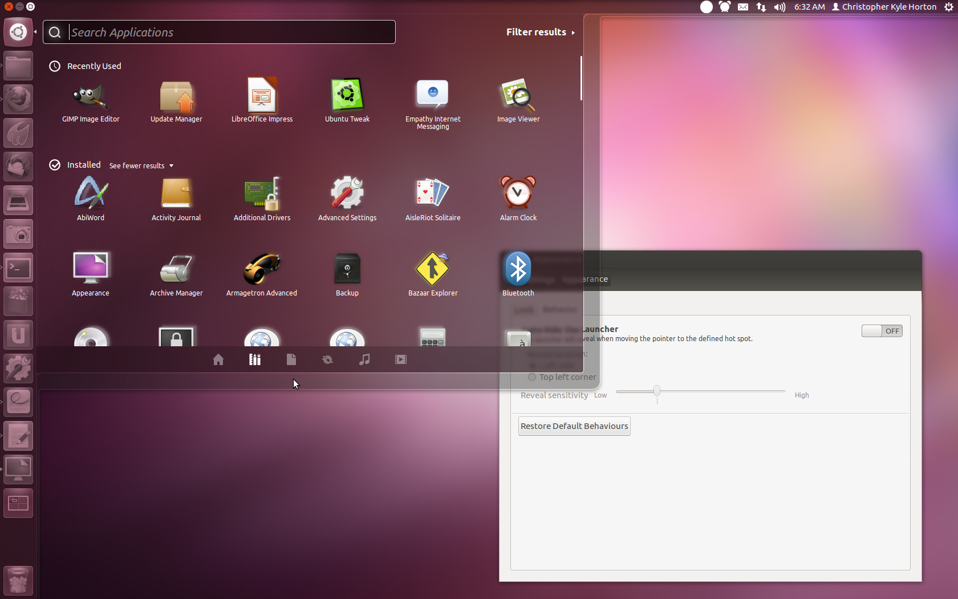
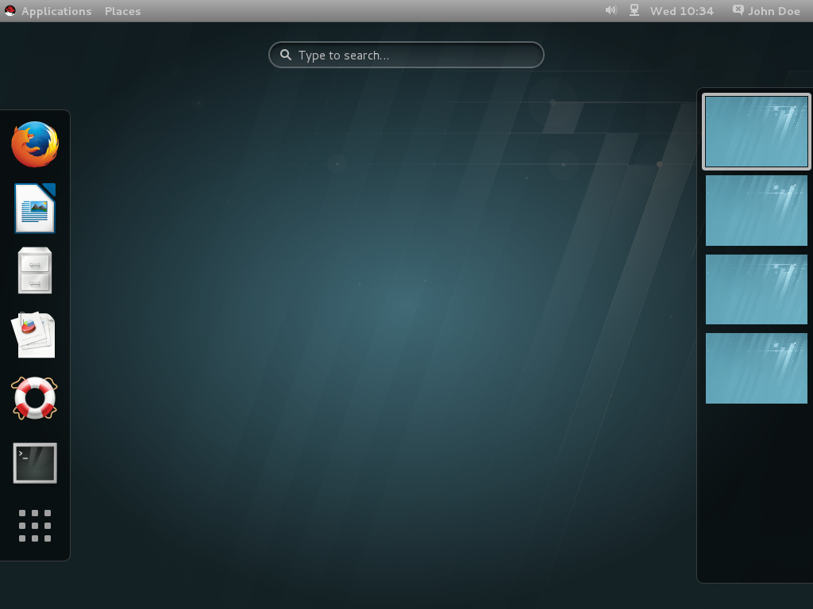
Linux
Linux programmers don’t all work for one company. There are different versions of Linux, like Ubuntu and Red Hat.
These versions look different and are for different purposes, like a server or a desktop PC.
Ubuntu
Linux
Red Hat
Linux

Slide 43
Programs
Programs (or application or app) are software that do a specific job. A calculator program’s job is just to do math.
You can have dozens of different programs.
You’ll have different programs for typing reports, games, graphics, browsing the Internet, and more.

Slide 44
Programs
For the computers you’re going to build, programs need to work on the Ubuntu OS.
Most programs you download from the Internet won’t work.
There is a special program called Ubuntu Software Center that finds programs that will work.

Slide 45
Programs
Programs have to be run on the right OS. They won’t work on a different OS unless the programmer has written a different version.
It’s like Xbox and Playstation games. Every game is a program. An Xbox game won’t run on a Playstation. Sometimes the same game is on both, but you still can’t use the Xbox disc in the Playstation.
When you’re looking for a program, you have to get a version that is written just for your computer’s OS.

Slide 46
Activity Worksheet

Slide 47
Installing an Operating System
You install, or load, an OS onto a computer by using a simple program on a USB drive or CD/DVD.
This will replace any OS already on the computer’s hard drive!
At Kramden we have an OS Load process that uses a USB drive with the Ubermix OS.

Slide 48
Let’s Install an OS
Follow along with the OS Load Instructions for the computer at your station.

Slide 49
OS Load
Check the computer. Is it clean inside and out? Does it have any loose or broken parts?
Plug in all the peripherals.
Plug in the Ubermix USB drive.

Slide 50
OS Load
Boot up the computer.
Wait for the Ubermix installation menu.
Type “1”, then type “yes”.
Wait until the installation program says it is done.

Slide 51
OS Load
Remove the USB drive and restart the computer.
Ubermix should start up. Type in the password, which is “password”.
STOP.

Slide 52
About Ubermix
Ubermix is a version of Ubuntu.
It’s easy to use and runs fast on refurbished computers.
It doesn’t get viruses or other bad programs.
It comes with 60 programs, including games, programs for schoolwork, Web browsers, and more.

Slide 53
About Ubermix
Kramden Institute uses UberMix on almost all of its computers because it’s great for kids -- and adults, too.

Slide 54
OS Load
Set time and date.
Restart the computer using the Shutdown item in the System menu.
Shutdown the computer.
Check the boxes on the tracking sheet. Sign and date it.

Slide 55
Install Ubermix on another
computer
Follow the OS Load Instructions carefully. Raise your hand if you have any questions or get stuck.

Slide 56
Remove the USB drive and restart the computer.
Ubermix should start up. Type in the password, which is “password”.
Set time and date.
Restart the computer once using the Shutdown menu item in the System menu.
Shutdown the computer using the Shutdown menu item.
Check the boxes on tracking sheet. Sign and date it.
OS Load Steps
Make sure the computer is clean and not broken.
Plug in all the peripherals.
Plug in the Ubermix USB drive.
Boot up the computer.
Wait for the Ubermix installation menu.
Type “1”, then type “yes”.
Wait until the installation program says it is done.

Slide 57
Workshop: Triage Plus OS Loading
Let’s take a quick break and then head into the workshop area to refurbish more computers and load the Ubermix OS on them.

