Slide 1
Performing Mail Merges
Lesson 11

Slide 2
Objectives

Slide 3
Software Orientation
Commands on the Mailings tab are used to perform mail merges, as well as to create envelopes and labels for a group mailing.
Use this slide as a reference throughout this lesson as well as the rest of this book.

Slide 4
Setting Up Mail Merge
Mail merges are useful for creating multiple documents that have the same basic content, and personalizing them with unique information from a data source—for example, a form letter, sent to multiple customers using different recipient names and addresses.
In essence, mail merges are used for internal and external correspondence such as memorandums, labels, invitations, and more.
The mail merge document contains the same information that everyone will receive.

Slide 5
Setting Up Mail Merge
The individuals receiving the document are created in a data source, which is the list of recipients and contains information for each individual with variable data, such as the person’s first and last name, address, city, state, zip code, phone number, and etc.
The data source can be created as a database using Word where Word provides the fields and you key the data in them.
You also customize the fields to fit your document. Other programs can be used for the data source such as an Excel worksheet, an Access table or query, or your Outlook contacts list.

Slide 6
Setting Up a Main Document Using the Mail Merge Wizard
To begin a mail merge, the main document is set up from a new or an existing document.
The main document contains the text and graphics that are the same for each version of the merged document.
In this exercise, you learn to set up a main document using the Mail Merge Wizard, setting up mail merge manually, using the Auto Check for Errors, and previewing and printing the merge document.

Slide 7
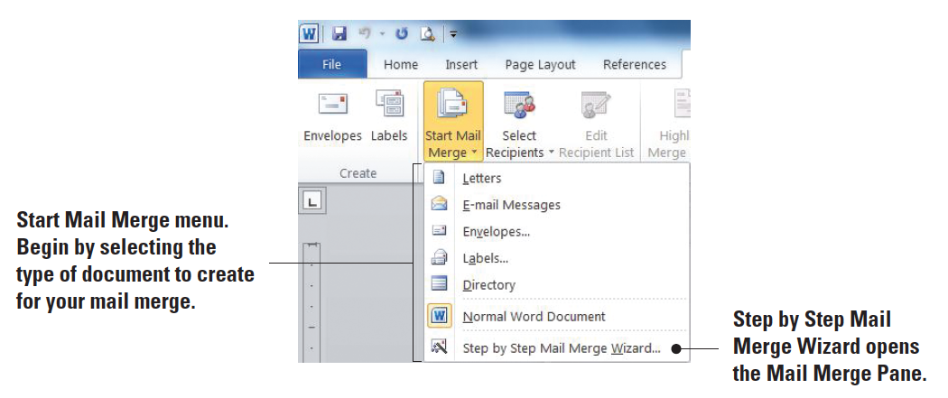
Step-by-Step: Set Up a Main Document Using the Mail Merge Wizard
Before you begin these steps, be launch Microsoft Word.
On the Mailings tab, in the Start Mail Merge group, click the drop-down arrow to display the Start Mail Merge menu as shown below.

Slide 8
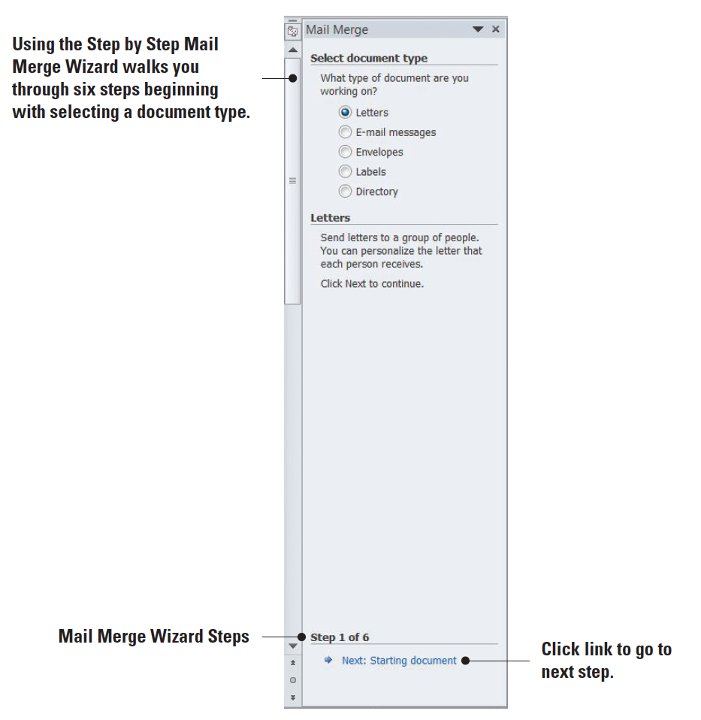
Step-by-Step: Set Up a Main Document Using the Mail Merge Wizard
Click Step by Step Mail Merge Wizard. The Mail Merge pane opens as shown at right. The mail merge wizard has six steps to complete.

Slide 9
Step-by-Step: Set Up a Main Document Using the Mail Merge Wizard
STEP 1
Under the section, Select document type, Letters is the default. You will be using the default for the main document.
Click the link below the Mail Merge pane, Next: Starting document.

Slide 10
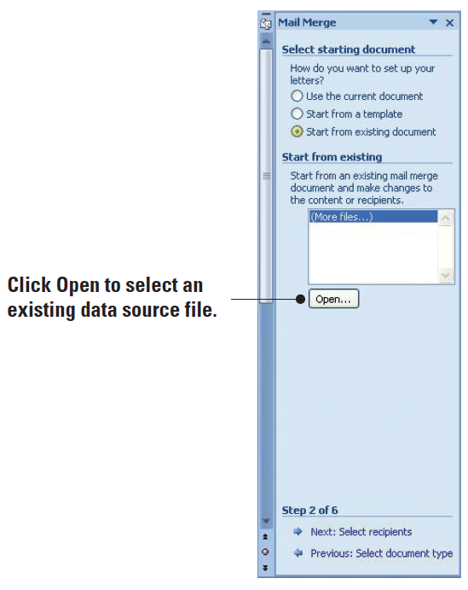
Step-by-Step: Set Up a Main Document Using the Mail Merge Wizard
STEP 2
This step contains three options on setting up the letter. You will open an existing document in the lesson folder. Below the section Select starting document, click the radio button Start from existing document. Below the section, Start from existing, click the Open button as shown at right.

Slide 11
Step-by-Step: Set Up a Main Document Using the Mail Merge Wizard
STEP 2
The Open dialog box displays. Use the scroll bar to locate your USB flash drive and open data files from your lesson folder. Select the scholarship document and double-click to open it or click the Open button. The document is inserted in the document screen.
At the bottom of the Mail Merge pane, click the link, Next: Select recipients.

Slide 12
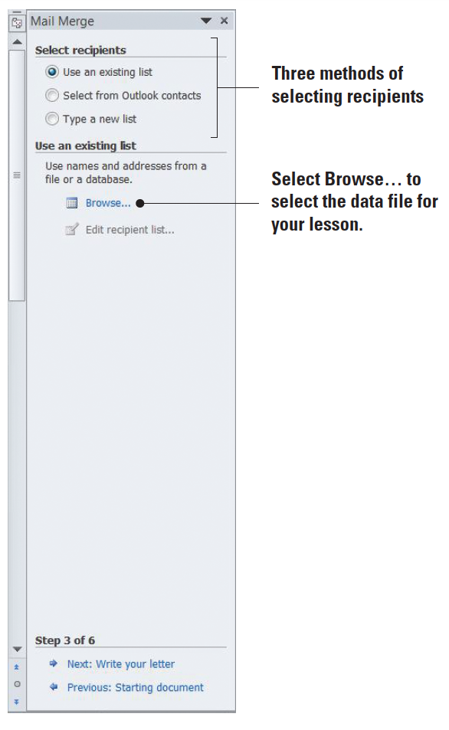
Step-by-Step: Set Up a Main Document Using the Mail Merge Wizard
STEP 3
Under the Select recipients section (right) you will use the default setting, Use an existing list. The existing list is located in the data lesson folder in your USB flash drive.

Slide 13
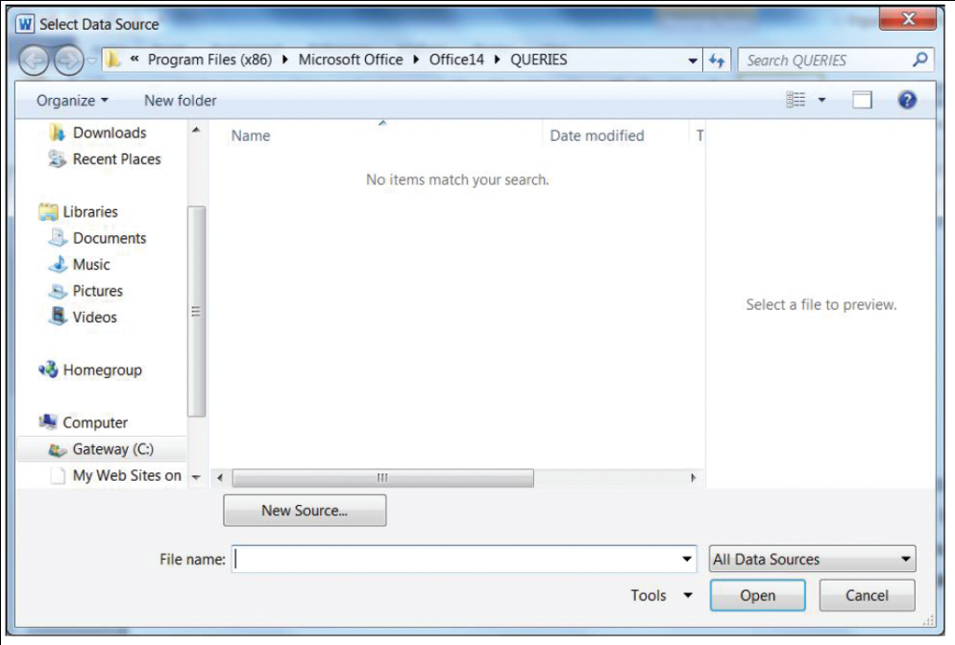
Step-by-Step: Set Up a Main Document Using the Mail Merge Wizard
STEP 3
Under the Use an existing list section, click the Browse link. The Select Data Source dialog box opens—this is the default location for data source files (right). Use the scroll bar to navigate to the location of your data lesson folder in your USB flash drive.

Slide 14
Step-by-Step: Set Up a Main Document Using the Mail Merge Wizard
STEP 3
A data source is a file that contains information to be merged in the main document. A data source can be from an Excel spreadsheet, an Access database, an HTML file, or a Word document containing a single table, an electronic address book such as Outlook, or any text that has data fields. Field names provide a description for the specific data, such as a person’s first name, last name, address, city, state, and zip code, to be merged from the data source.

Slide 15
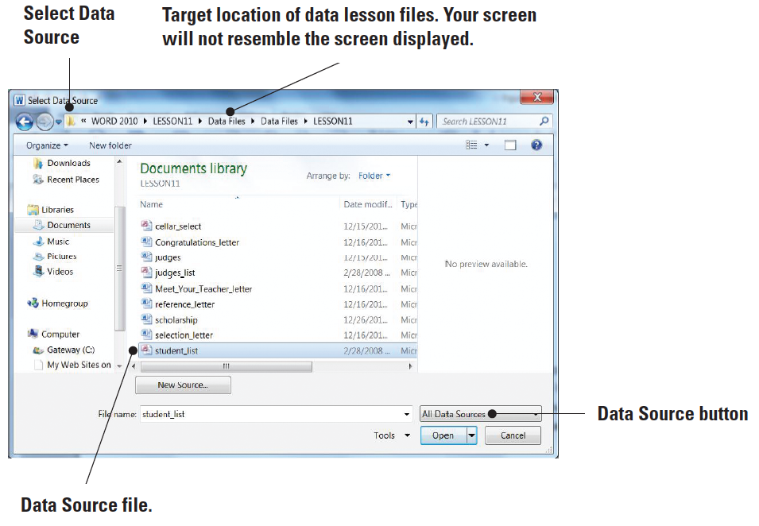
Step-by-Step: Set Up a Main Document Using the Mail Merge Wizard
STEP 3
Select the student_list as shown at right and double-click or click the Open button. The icon listed for the student_list is a data- base file. A database is a collection of information that is organized so that you can retrieve information quickly. The student_list file is the data source that will be merged with the letter in the document screen.

Slide 16
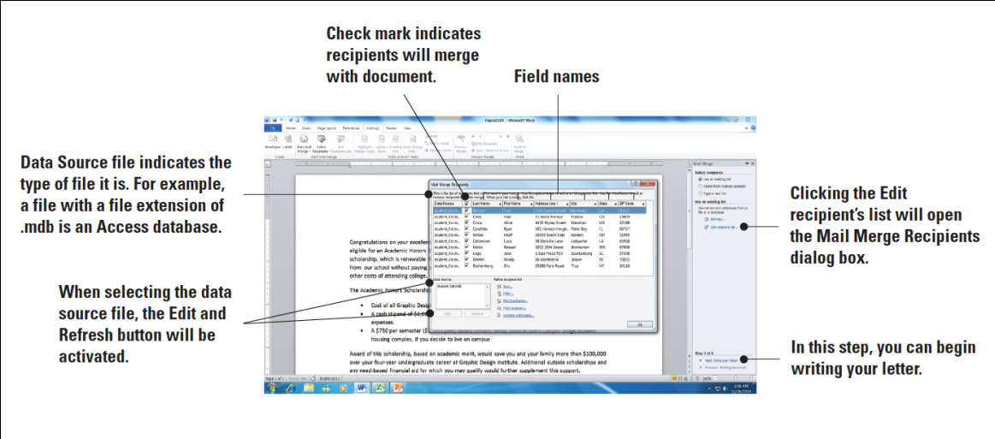
Step-by-Step: Set Up a Main Document Using the Mail Merge Wizard
STEP 3
The Mail Merge Recipients dialog box opens as displayed at right. The Mail Merge Recipients dialog box has been expanded to display all fields and records. The check mark indicates that all recipients’ fields will merge with the document. You can choose not to send a recipient a letter by unchecking the check box. When the document merges, all recipients with a check mark by their name will be merged with the document. Click OK to close the Mail Merge Recipients dialog box.

Slide 17
Step-by-Step: Set Up a Main Document Using the Mail Merge Wizard
STEP 4
At the bottom of the Mail Merge pane, click the link, Next: Write your letter. Since you have already opened an existing document, the document is ready for fields to be inserted.
Your insertion point is already positioned on the blank line above the first paragraph to insert the current date.
Click the Insert tab, in the Text group, and click the Date & Time button. The Date & Time dialog box opens, click the third option and click OK. The current date is inserted in the document.
Press Enter once.

Slide 18
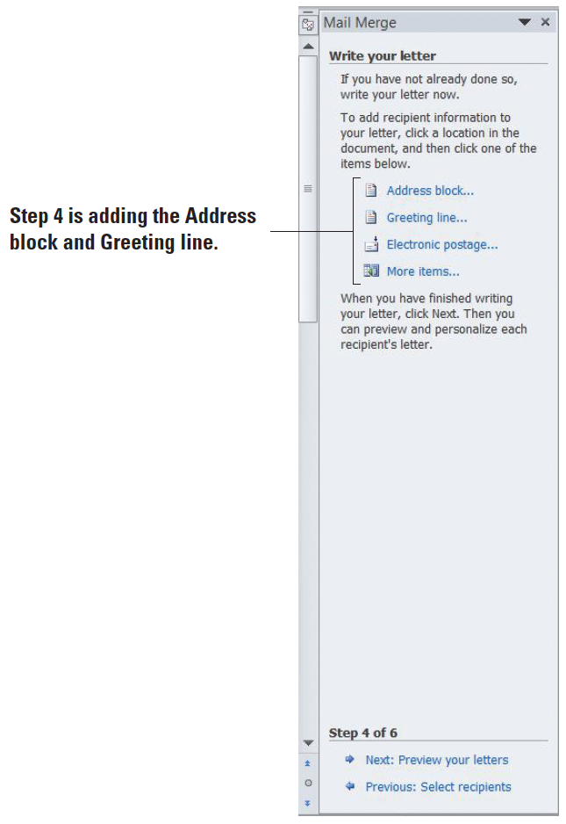
Step-by-Step: Set Up a Main Document Using the Mail Merge Wizard
STEP 4
In the Mail Merge pane, under the Write your letter section, it shows four links (see right). The Address block link contains the fields from the recipients list, the Greeting line link contains the salutation, the Electronic postage link will insert the electronic postage, and the More items link will open the Insert Merge Field dialog box, which provides an option to insert fields individually.

Slide 19
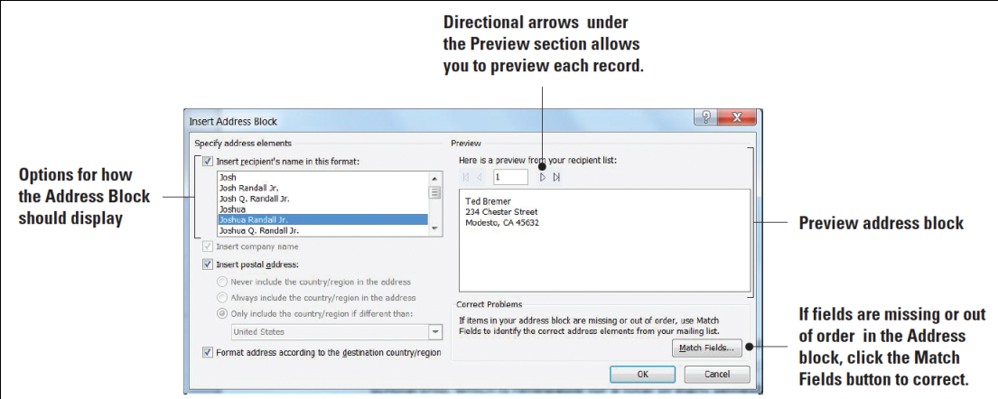
Step-by-Step: Set Up a Main Document Using the Mail Merge Wizard
STEP 4
Under the Write your letter section, click the Address block link. The Insert Address Block dialog box opens as shown at right. Under Specify address elements, the fifth option is selected with a specific format as displayed on the Preview section. On the Preview side, there are four arrows, First, Previous, Next, and Last. Notice that the First and Previous arrow buttons are grayed out. When these arrow buttons are shaded in gray, it indicates that these are not available. The first recipient’s name and address is displayed and when you click the Next or Last arrow, the First and Previous arrows become avail- able. Click the Next arrow and preview the ten records in the recipient list, then click the First button to return to the first recipient. Click OK.

Slide 20
Step-by-Step: Set Up a Main Document Using the Mail Merge Wizard
STEP 4
A field code <<Address Block>> is inserted in the document as shown below. The field name is surrounded by chevrons (<< >>) and will not display in the merged document. When the document is merged, the Address Block will display the recipients’ first and last name, address, city, state, and postal code.

Slide 21
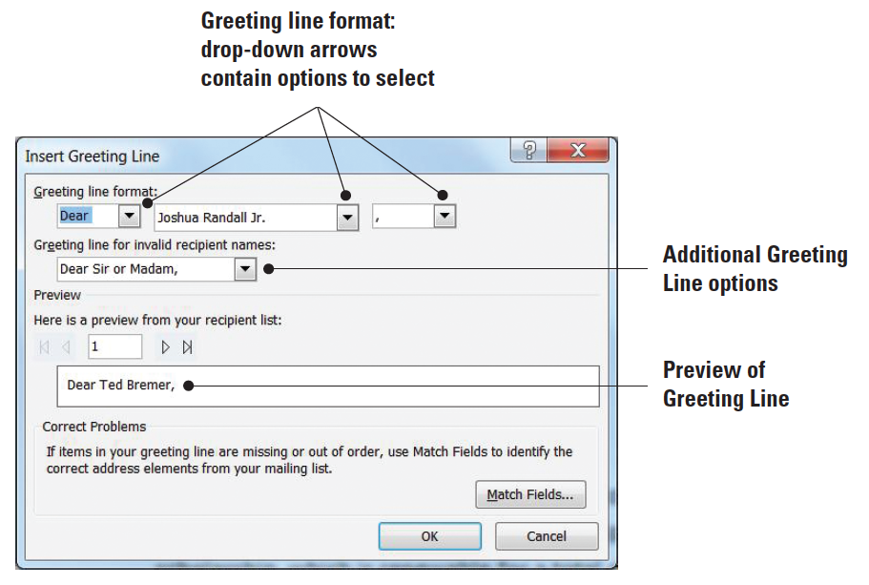
Step-by-Step: Set Up a Main Document Using the Mail Merge Wizard
STEP 4
Press the Enter key once.
Click the Greeting line link to open the Insert Greeting Line dialog box as shown at right The drop-down arrows under the Greeting line format provide options to select the salutation, name, and punctuation. You will use the salutation Dear for the letter.

Slide 22
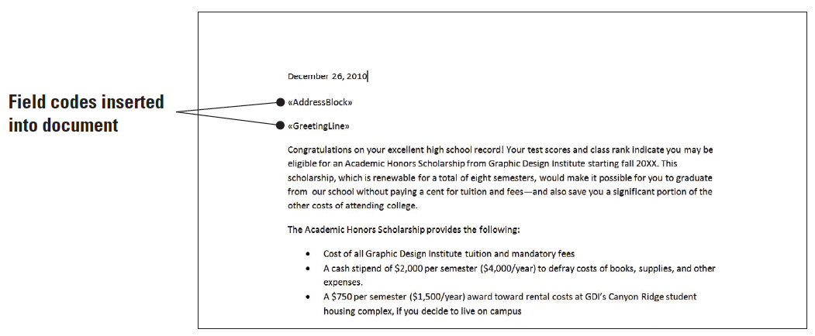
Step-by-Step: Set Up a Main Document Using the Mail Merge Wizard
STEP 4
Click the drop-down arrow next to Joshua Randal Jr. to view the options. Keep the default as the selection.
Click the drop-down arrow next to the comma and select the colon (:). Click OK. Your document should match the one below. You have inserted two field codes in your document.

Slide 23
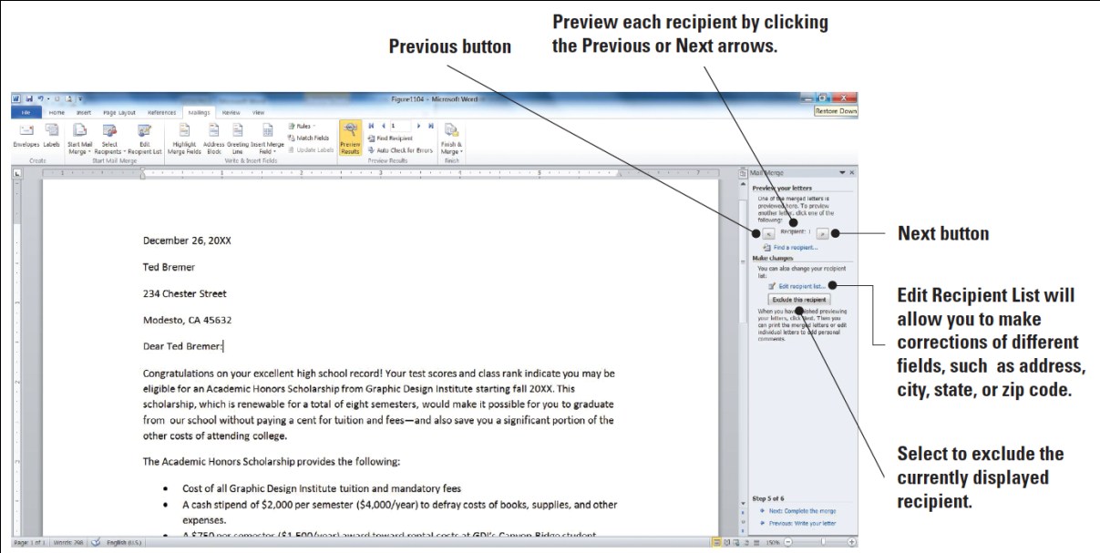
Step-by-Step: Set Up a Main Document Using the Mail Merge Wizard
STEP 5
At the bottom of the Mail Merge pane, click the link, Next: Preview your letters. Notice the first recipient, Ted Bremer appears in the document. On the Mail Merge pane, preview each letter in the document screen by using the buttons as shown above. Click the Next button, preview each letter, and return to the first recipient.

Slide 24
Step-by-Step: Set Up a Main Document Using the Mail Merge Wizard
STEP 5
Before finalizing the merge, the mailing address contains extra spaces between the lines that need correction. Select the text beginning with Ted Bremer, the address through the zip code, 45632.
On the Home tab, in the Paragraph group, click the drop-down arrow to display the Line and Paragraph Spacing menu and select Remove Space Before Paragraph.

Slide 25
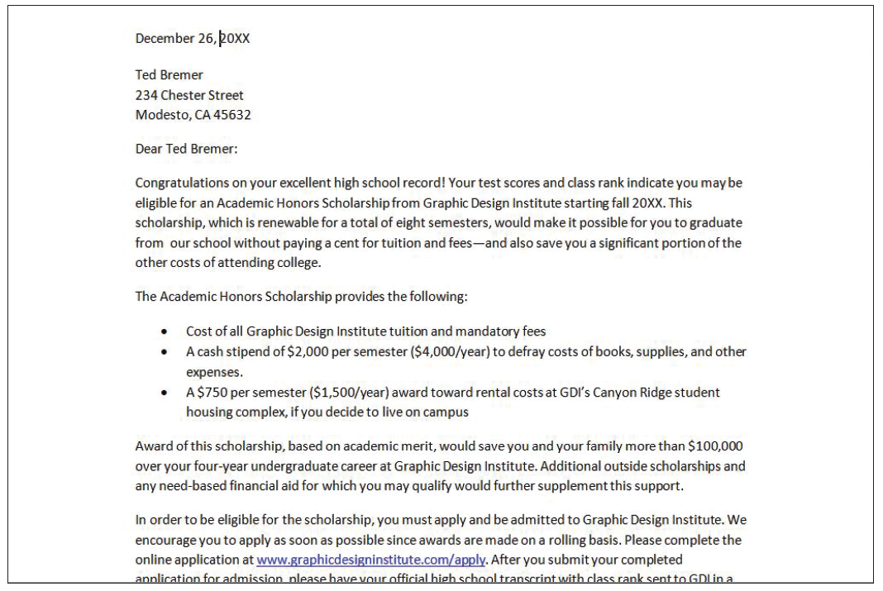
Step-by-Step: Set Up a Main Document Using the Mail Merge Wizard
STEP 5
Place the insertion point in the date. In the Para- graph group on the Home tab, click the drop-down arrow to display the Line and Paragraph Spacing menu and select Add Space After Paragraph. This separates the date from the Address Block. The document should display as above. Preview each letter again by using the Next and Previous buttons on the Mail Merge pane and return to the first recipient. Each recipient should be in the correct format.

Slide 26
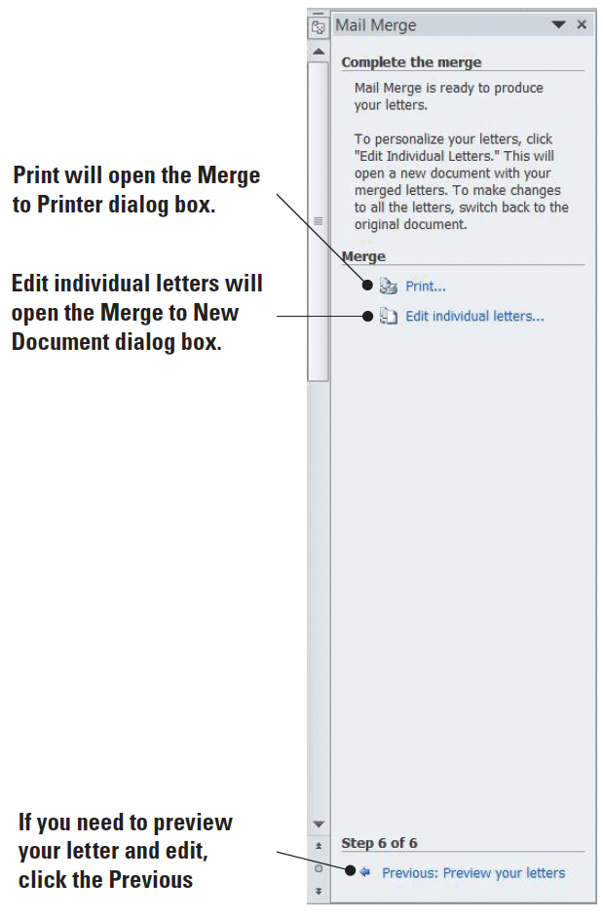
Step-by-Step: Set Up a Main Document Using the Mail Merge Wizard
STEP 6
At the bottom of the Mail Merge pane, click the link, Next: Complete the merge to advance to Step 6 as shown at right. The letter is already merged and ready to Print or you can edit each letter individually. When you click the link Edit individual letters under the Merge section, the Merge to New Document dialog box opens. When you select the All radio button, then All letters will open as a new document, and Letters1 will display on the title bar. When you finish editing the letters,

Slide 27
Step-by-Step: Set Up a Main Document Using the Mail Merge Wizard
STEP 6
you are ready to save the letters—all letters will be saved as one document. If your insertion point is on the third letter, and you click the link Edit individual letters and then select the radio button for Current Record, the document will open in a new screen with the third document as a new document and Letters followed by a number will appear on the title bar. Edit the document and when you save the document, only the third letter will be saved with the changes made. Selecting the third radio button From, you key the beginning number to the end number of the document you wish to edit. For example, if you wish to edit letter 3 through 5, you would key 3 to 5 in the From boxes.

Slide 28
Step-by-Step: Set Up a Main Document Using the Mail Merge Wizard
STEP 6
Under Mail Merge pane, in the Merge section, click Print to print each letter. The Merge to Printer dialog box opens with three options to select. Selecting the All radio button will print all letters, the Current record will print the record where your insertion point is located, and From is where you specify which records to print. For example, if you specify records 2 to 4—only those two records will print. Make sure the All radio button is selected and click OK to print.
Close the Mail Merge pane.
SAVE the merge document as congratulation_letter_merged in your USB flash drive in the lesson folder and CLOSE the file.
LEAVE Word open to use in the next exercise.

Slide 29
Setting Up a Main Document Manually
You can begin working with Mail Merge by keying your letter and using an existing data source, creating your own data source list and keying your recipients’ information, or using Outlook to get your contacts from.
You don’t need to have the Access program installed on your computer because Word makes it easy to create your list of recipients. It is easy to create a database in Word because the fields are already identified for you.
After setting up your document, the address block and greeting line are inserted the same way they were in the step by step mail merge wizard.

Slide 30
Setting Up a Main Document Manually
You can preview your results and check for errors using the tools available in the Preview Results group, and then perform the merge.
In this exercise, you will create a document, key information, insert an existing data source, insert the address block and greeting line, check for errors in the document, preview the letters, and merge.

Slide 31
Step-by-Step: Set Up a Main Document Manually
Create a new blank document, click the File tab, then click New, and click Create.
Click the Mailings tab, and in the Start Mail Merge group click the drop-down arrow to display the Start Mail Merge menu.
Choose Letters. (The same letter and data source used in the previous exercise will be used to perform the mail merge manually.)
LEAVE Word open to use in the next exercise.

Slide 32
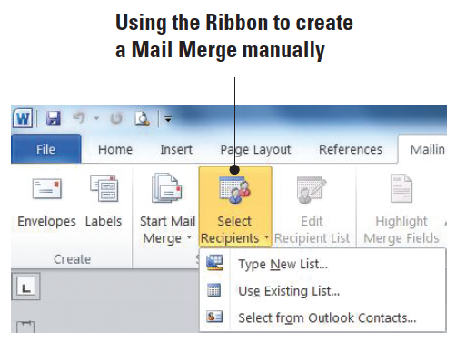
Step-by-Step: Select Recipients
In the Start Mail Merge group, click the drop-down arrow to display the Select Recipients menu as shown at right. There are three options available. (You will be opening an existing data source file from your lesson folder. Notice the commands on the Ribbon are faded, therefore, not available until a data source file is opened).

Slide 33
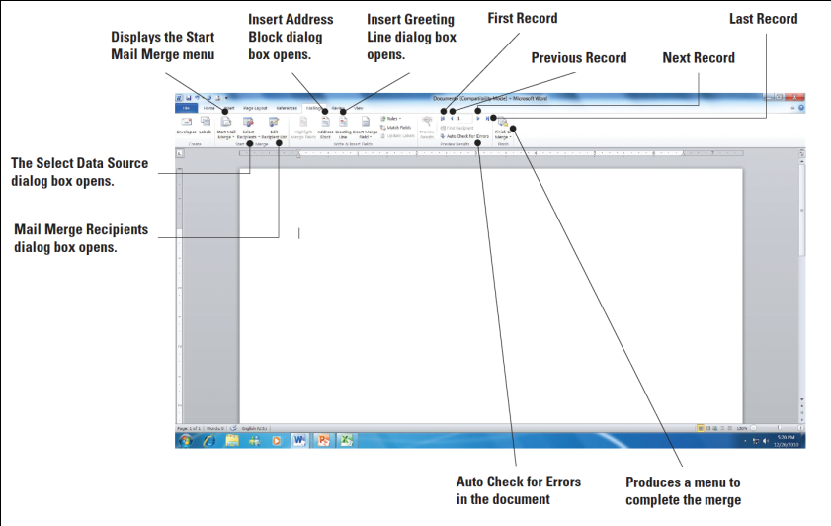
Step-by-Step: Select Recipients
Select Use Existing List. The Select Data Source dialog box opens. Use the scroll bar to locate your USB flash drive and navigate to your data files for the lesson folder.
OPEN the student_list data source file from the lesson folder. The student_list file is a database. After opening the data source file, the commands on the Ribbon become active (see right). When selecting a data source file, this file can be a database, an Excel spreadsheet, a table in Word, or it can be opened from your Outlook contacts.
At the insertion point, key March 19, 2011. Press the Enter key twice.
LEAVE the document open to use in the next exercise.

Slide 34
Step-by-Step: Prepare Merge Fields
USE the document open from the previous exercise.
On the Mailings tab, in the Write & Insert Fields group, click the Address Block button. The Insert Address Block dialog box opens. Click OK. Refer to the figure shown on Slide 33. When using the Mail Merge Wizard or completing the Mail Merge manually, the same dialog boxes are opened.
Press the Enter key once.
On the Mailings tab, in the Write & Insert Fields group, click the Greeting Line button. The Insert Greeting Line dialog box opens.
For the Greeting Line format, the salutation Dear will be used. You will use the default where Joshua Randal Jr. is shown. Click OK. Press the Enter key once.
LEAVE the document open to use in the next exercise.

Slide 35
Step-by-Step: Write the Letter
USE the document open from the previous exercise.
1. Key the following letter:
The President of the College, Dr. Jose A. Torres, is extending an invitation to all students who received scholarships for the next academic semester. The Graphic Design Institute recognizes all students for their academic excellence. A reception is being held in your honor on March 29 at 12 noon in the President’s Conference Room 19. [Press Enter once]
Please confirm your attendance by calling 915-999-9999. [Press Enter once]
Regards, [Press Enter twice]
Jerry Wright [Press Shift+Enter to insert a line break]
Scholarship Committee Chair
LEAVE the document open to use in the next exercise.

Slide 36
Step-by-Step: Preview the Document
USE the document open from the previous exercise.
In the Preview Results group, click the Preview Results button. The first recipient appears. Click the Next Record arrow button to preview the letters for each recipient. Turn Preview Results off.
Place the insertion point in the <<AddressBlock>> field. Click the Home tab, and then in the Paragraph group, click the Line and Paragraph Spacing button then click Remove the Spacing After Paragraph.
Place the insertion point in the Greeting line and click the Page Layout tab. In the Paragraph group, click the up arrow until you see 6 pt. The Spacing Before is increased by 6 pts and separates the address block and greeting line.

Slide 37
Step-by-Step: Preview the Document
On the Page Layout tab, in the Page Setup group, click the Margins button, then Custom Margins. Key 2 in the Top box to change the top margin. Customized letterheads are used by organizations to print their letters. The top margin must be adjusted to avoid text printing over the organization’s logo. Click OK.
Click the Mailings tab, in the Preview Results group, click the Preview Results button to view the formatting changes made to the document. Turn Preview Results off.
The main document is the document that contains the body of the letter as well as the Address Block and Greeting Line. Save the main document as reception_letter in your USB flash drive in the lesson folder. Saving the main document as a separate document will allow you to merge with a new data source file—when you need to use the same letter again but with a different recipient listing.
LEAVE the document open to use in the next exercise.
Notes:
Take Note: Once the main document has been set up, you can format at the beginning of the mail merge process.

Slide 38
Executing Mail Merge
The final steps in a mail merge are to check for errors, preview the merge, and finalize the merge.

Slide 39
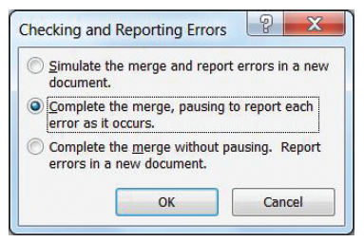
Step-by-Step: Check for Errors
USE the document open from the previous exercise.
On the Preview Results group, click the Auto Check for Errors button. The Checking and Reporting Errors dialog box opens as shown at right. Select the first option, Simulate the merge and report errors in a new document.
A prompt will appear indicating No mail merge errors have been found in the reception_letter. Click OK.
LEAVE the document open to use in the next exercise.

Slide 40
Step-by-Step: Complete the Merge
USE the document open from the previous exercise.
In the Finish group, click the drop-down arrow to display the Finish & Merge menu as shown below.

Slide 41
Step-by-Step: Complete the Merge
Select Edit Individual Documents. The Merge to New Document dialog box opens as shown below. The All option will merge all letters to a new document, Current record will merge only that record from where your insertion point is positioned, and in the From option, you key the first record and end record to merge. For instance, if you wanted to merge only records 2 and 3, you would key 2 to 3.

Slide 42
Step-by-Step: Complete the Merge
For this exercise, in the From section key 3 in the first box and in the To box, key 5. Click OK. A new document is produced that displays letters for records 3 through 5 in one document. Scroll through the document to preview that the document is ready to print.
SAVE the merged document as receptionletter_merged in your USB flash drive in the lesson folder and CLOSE the file.
CLOSE the mail document reception_letter and a prompt will appear asking, Do you want to save changes made to reception_letter? Click Yes. When you save the main document with the field codes, you will be able to return to your document and recipient list and use the tools available in the Mailings tab. You can also edit the list of recipients and open another data source to send the same letter to another group.
CLOSE Word.
Notes:
Troubleshooting: A document must be opened in Word for the mail merge commands to be available.

Slide 43
Lesson Summary

