Slide 1
Principles of business
Objective 1.02: Record information to maintain and present a report of business activity.

Slide 2
Objective Content
Utilize note-taking strategies
Organize information
Select and use appropriate graphic aids.

Slide 3
Utilize note-taking strategies
Why is it important to take notes?
Helps you to concentrate in class and remember important information.
Helps you prepare for tests and other assignments.
Helps you to understand material.
Provides valuable clues for what information, themes, and processes are most important.
Notes:
Remember important information - Studies have shown that within two weeks you probably will forget 80 percent or more of what you have heard. And in four weeks you are lucky if 5 percent remains.
Review - It’s very important to read over your notes as much as possible so that you don’t forget. The more you read your notes, the less you forget.
Understand material - If the material that you’re learning is exceptionally difficult, taking notes helps you to understand the information. This is especially the case if you paraphrase by using your own words when taking notes. Also, during class discussions, someone else may say something that helps you to better grasp the information. It’s always a good idea to include that into your notes.

Slide 4
Note-taking strategies
Cornell two-column note-taking
Outlining
Mapping
Charting

Slide 5
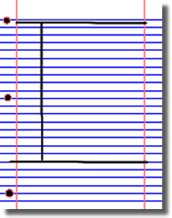
1. Cornell two-column note-taking
Divide the paper into 3 sections
Draw a dark horizontal line about 5 or 6 lines from the bottom.
Draw a dark vertical line about 2 inches from the left side of the paper from the top to the horizontal line.

Slide 6
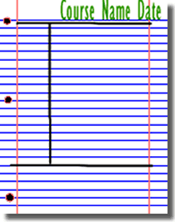
1. Cornell two-column note-taking
Document
Write course name, date, and topic at the top of each page.

Slide 7
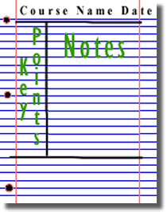
1. Cornell two-column note-taking
Write notes.
The Large box to the right is for writing notes.
Skip a line between ideas and topics.
Don’t use complete sentences. Use abbreviations, whenever possible.

Slide 8
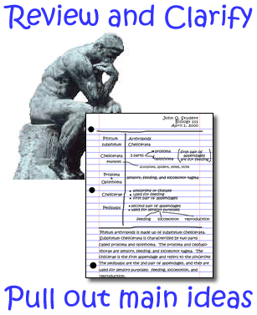
1. Cornell two-column note-taking
Review and clarify.
Review the notes as soon as possible after class.
Pull out main ideas, key points, dates, and people, and write these in the left column.

Slide 9
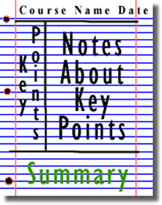
1. Cornell two-column note-taking
Summarize.
Write a summary of the main ideas in the bottom section.

Slide 10
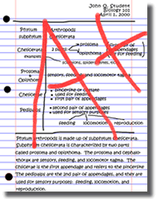
1. Cornell two-column note-taking
Study your notes.
Re-read your notes in the right column.
Spend most of your time studying the ideas in the left column and the summary at the bottom. These are the most important ideas & will probably include most of the information that you will be tested on.

Slide 11
2. Outlining
Start main points at the margin.
Indent secondary and supporting details.
Further indent major subgroups.
Definitions, for example, should always start at the margin.
When a list of terms is presented, the heading should also start at the margin.
Each item in the series should be set in slightly from the margin.
Examples, too, should be indented under the point they illustrate.
When the lecturer moves from one idea to another, show this shift with white space by skipping a line or two.

Slide 12
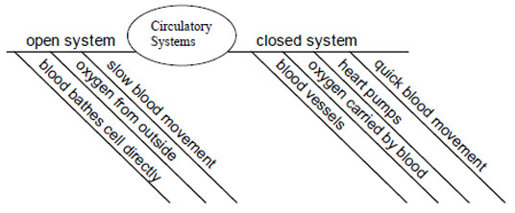
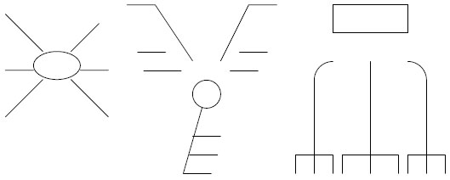
3. Mapping
Mapping is a visual system of condensing material to show relationships and importance. A map is a diagram of the major points, with their significant sub-points, that support a topic. The purpose of mapping as an organizing strategy is to improve memory by grouping material in a highly visual way.

Slide 13
4. Charting
If the lecture format is distinct (such as chronological), you may set up your paper by drawing columns and labeling appropriate headings in a table.

Slide 14
Abbreviations for Note-Taking
Don’t try to perfect a definite system of “shorthand”. Use what works for you.
Symbols
Standard Abbreviations
First Syllable
Does not equal
∆
Change
≠
Dept
Department
NYC
New York City
Ex
Example
Pol
Politics
Lib
Liberals
Dem
Democracy
Cap
Capitalism

Slide 15
Common Errors in Note-Taking
Notes:
Click on picture hyperlink to review “Note to Self: Try to Avoid the Four Big Note-Taking Mistakes”

