Slide 1
Principles of Business and Finance
5.03 Notes
Finish Franchise Project
Begin Basic Business Idea Project

Slide 2


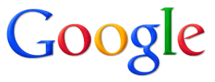

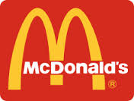
Main Business Types
Sole Proprietor
  McDonalds + Walmart started as one
Partnership
  Google, Ben & Jerry’s, Apple, Microsoft, Warner Bros Started as partnerships.
Corporation

Slide 3


Sole Proprietor
A business owned by one person
Most common legal form of ownership for new businesses
15-20 Million sole proprietors in United States
Accounts for 75% of businesses in US
Examples:
  Landscaping
  Computer Repair
  Photography
  Tutoring
  Maid Service

Slide 4
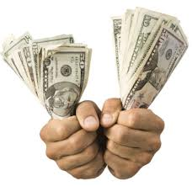
Sole proprietor
Pros:
  Control the entire business
  Keep all of the profits
  Make decisions quickly
  Easy to establish
  Pay fewer taxes
Cons
  Unlimited liability (debts)

Slide 5
Partnership
A business owned by 2 or more persons who share responsibilities and profits/losses
3 Million business partnerships in United States
Partnership Agreement (not filed with the government)
  Name of the new business
  Amount each person is to invest in the business
  Amount each partner is to draw in salary/profit
  How profits/losses after salaries are paid will be shared in proportion to each partner’s investment
  Responsibilities of the partners in the entity
  What will happen in the event of death of a partner(s)

Slide 6
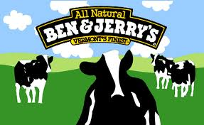

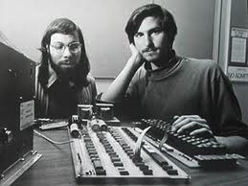
Partnership
Pros:
  Combine talents and financial resources
  Share in responsibility of running the business and making decisions
  Pays less taxes than a corporation
Cons:
  Unlimited liability (debts)
  Potential for disagreements
  Loss of partner could mean end of business

Slide 7
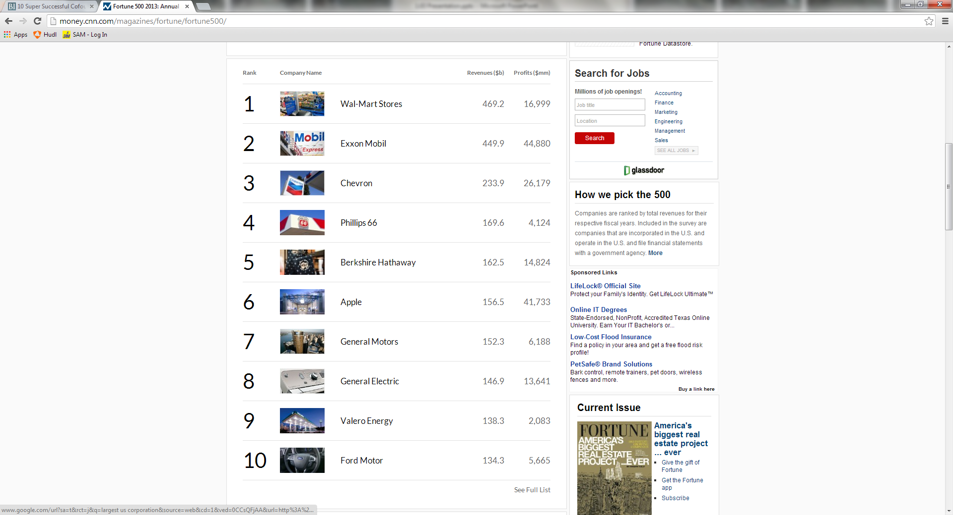
Corporation
A business organization that operates as a legal entity separate from its owners
Recognized as a person under the law
Require Articles of Incorporation
Sell Stock
Higher revenues

Slide 8
Corporation
Key Terms
  Stockholders/Shareholders: People who own stock in a corporation
  Board of Directors: A group of people elected by shareholders to guide a corporation
  Corporate Officers: are the directors and senior level management of a corporation
  Charter: a license to operate from that state
  Proxy: ability of a shareholder to vote on the affairs of a company

Slide 9
Corporation
Pros:
  Limited liability
  Share of the profits
  No management responsibility
  Can raise money by selling stock
  Easier to get credit
Cons:
  Legal red tape – Lots of laws to follow!
  Increased tax burden

Slide 10
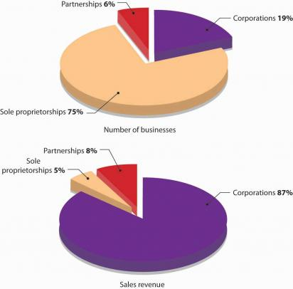
Business Ownership Distribution

Slide 11
Factors for type of business ownership
the potential risks and liabilities of your business
capital resources needed
your income tax situation
your investment needs

Slide 12

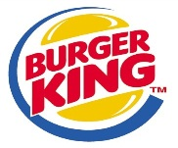






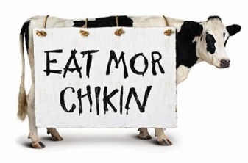

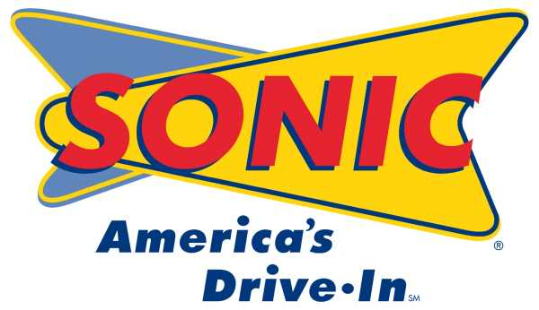
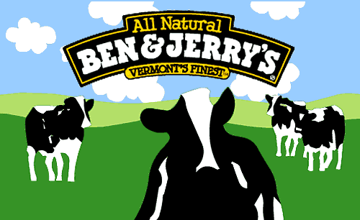





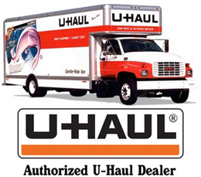

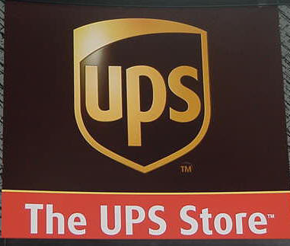
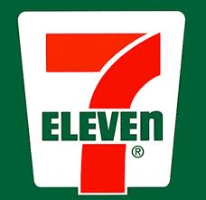

Franchise
A contractual agreement to sell a company’s products or services in a designated geographic area

Slide 13
Franchise
Franchisee: the person or group of people who have received permission from a parent company to sell its products or services
Franchisor: the parent company that grants permission to a person or group to sell its products or services
McDonald’s
  75% of restaurants worldwide are owned by franchisees
  Minimum $500,000 non-borrowed funds (25% cash)
  Monthly Service Fee – 4% of sales

Slide 14
Franchise
Pros:
  Name brand recognition
  Established method of doing business
  Access to centralized advertising
  Professional help in startup/training
Cons:
  High startup costs in purchasing rights to use the business name
  Must follow corporate standards

Slide 15
Other types of businesses
Extractors: A business that grows products or takes raw materials from nature
  Farming, mining
Producers: A business that gathers raw products in their natural state
  Apiary
Processors: Businesses that change natural materials (raw goods) into a more finished form for manufacturers to process further
  i.e. paper mills, oil refineries, steel mills, etc.

Slide 16
Other types of businesses
Manufacturers: A business that takes an extractor’s products or raw materials and changes them into a form that consumers can use
  Industrial production
  i.e. General Motors, GE, Dell, Intel
Distribution:
  Wholesale: A middle firm that assists with distribution activities between businesses
    i.e. Sams, CostCo
  Retail: A business firm that sells directly to the consumer
    i.e. Gap, Target

Slide 17
Other types of businesses
Service Firms: A business that does things for you instead of making products
  Intangible goods
  i.e. hospitality, banking, legal

Slide 18
Assignments
Create your own Business Intro Power-Point
  Sole Proprietorship in the RDU area
Slide 1 – Business Name and Logo with Slogan / Motto
  Be Original and Creative!
Slide 2 – Location / Hours
Slide 3 – Goods and Services Offered
Slide 4 – Images of goods / services
Slide 5 – Why is this products and services needed?
Slide 6 – Pros / Cons for your products and services?
Post on Canvas!
Examples of Business Names, Slogans, and Mottos below.

Slide 19
HANG 10
SURF
SHOP

Slide 20

Eclipse
Studios

Slide 21

MBF Pet Sitting

Slide 22
Doody Calls
Plumbing
We’re #1 in the #2 Business!

Slide 23
The Buck Stops Here
Taxidermy

