Slide 1
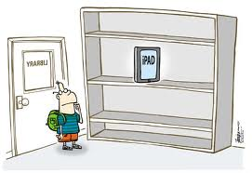
TechEd101 75 Classroom Apps in a Snap! (grades 6-12)
Regina Blount, CCNA, M.Ed.
(cte-rb.weebly.com)
Teachers CEU Classes

Slide 2
Notes:
Opening Slide
Some talking points to help you promote yourself and SDE as you open your presentation:
SDE has a 30-year history of bringing dynamic presenters and rich professional development content
Tell how long you’ve worked with SDE (if appropriate)
My goal today is to provide the right content that will enhance your teaching and lead to your students’ success!

Slide 3
In this Session
We are going to briefly discuss how mobile apps support differentiation and effective classroom instruction.
App-O-Rama: We’re going to move FAST to cover 75 Apps in 75 Minutes.
Transforming Classroom Instruction with iPads
http://www.youtube.com/watch?v=oYLirypK_Yo&feature=player_embedded

Slide 4
What Apps Can Do!
And a fun reminder about app versatility
http://www.youtube.com/watch?v=EhkxDIr0y2U

Slide 5
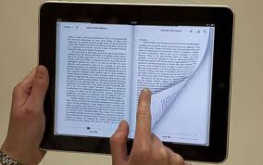
English/Language Arts

Slide 6
Students can actually create stories with pictures through templates.

Slide 7
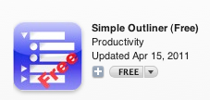
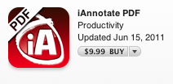
Apps for Research

Slide 8
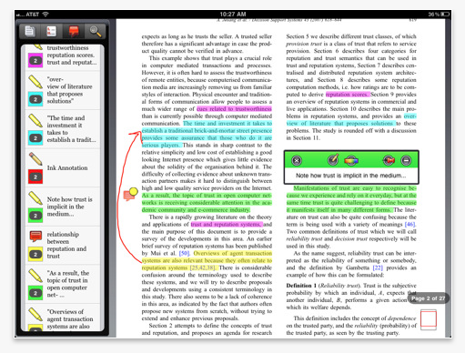
Sample from I Annotate

Slide 9
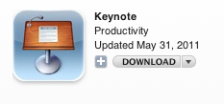
Composition Apps

Slide 10
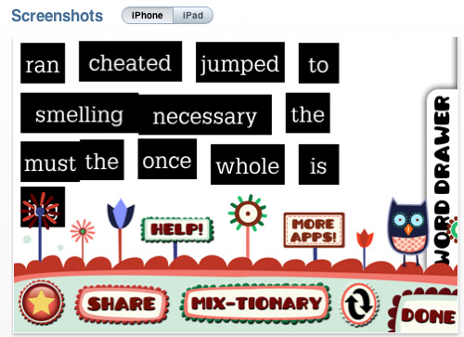
A Version of
Magnetic Poetry
Cost:
Free APP

Slide 11
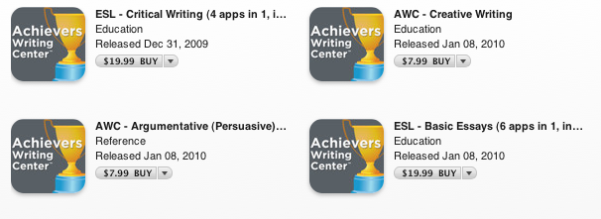
Achiever’s Writing Center
Best for: Teaching writing skills and strategies
Cost: Varies
Features: New feature called Essay Czar that is wonderful for college and high schools students.

Slide 12
Some Reminders about these apps:
Free APP
Dictionary.com
$.99 APP
Dictionary with Voice
Many languages are featured

Slide 13
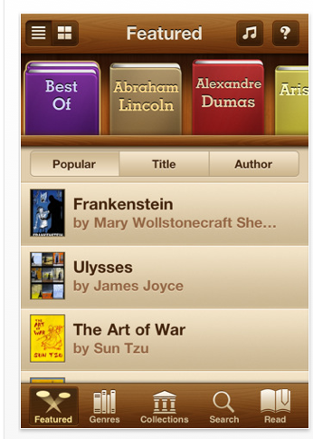
Numerous Apps to Get our Hands on Free Books
Free Books
Over 23,000 titles for $1.99

Slide 14
Free APP
Free and Purchase Books

Slide 15
Evernote: This is an amazing app for notetaking
This free APP is my current favorite.
I use it for note taking and it makes it easier to retrieve my notes.
The app “talks” to all of my mobile devices.

Slide 16
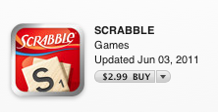
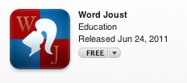
Word Play

Slide 17
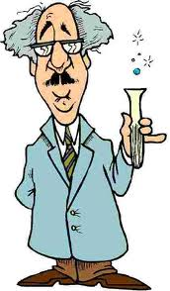
Science Apps

Slide 18
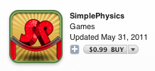
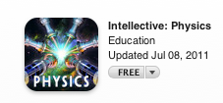
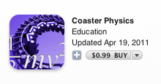
It Turns Out That There are a Ton of Awesome Physics Apps
Motion and Forces

Slide 19
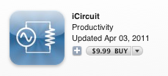
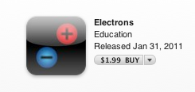
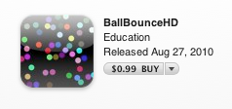
Electricity and Magnetism
Heat, Energy, and Work

Slide 20
And, of Course, There’s Angry Birds
Atlanta Teacher Uses Angry Birds for Physics Lessons - Education - GOOD | @scoopit via @NYSLP http://bit.ly/pXYZko
8 Jul Favorite Retweet Reply

Slide 21
More Science Apps

Slide 22
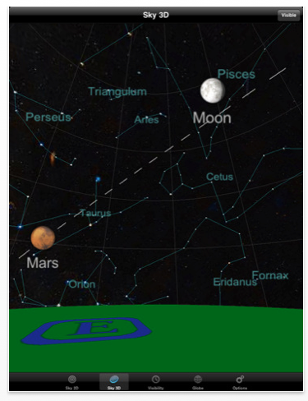
Planets: A Free App where students can view 3D models of the planets.

Slide 24
Biology Apps

Slide 25
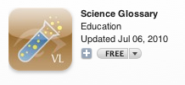
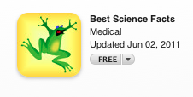
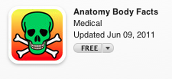
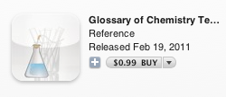
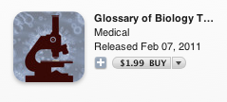

Slide 26
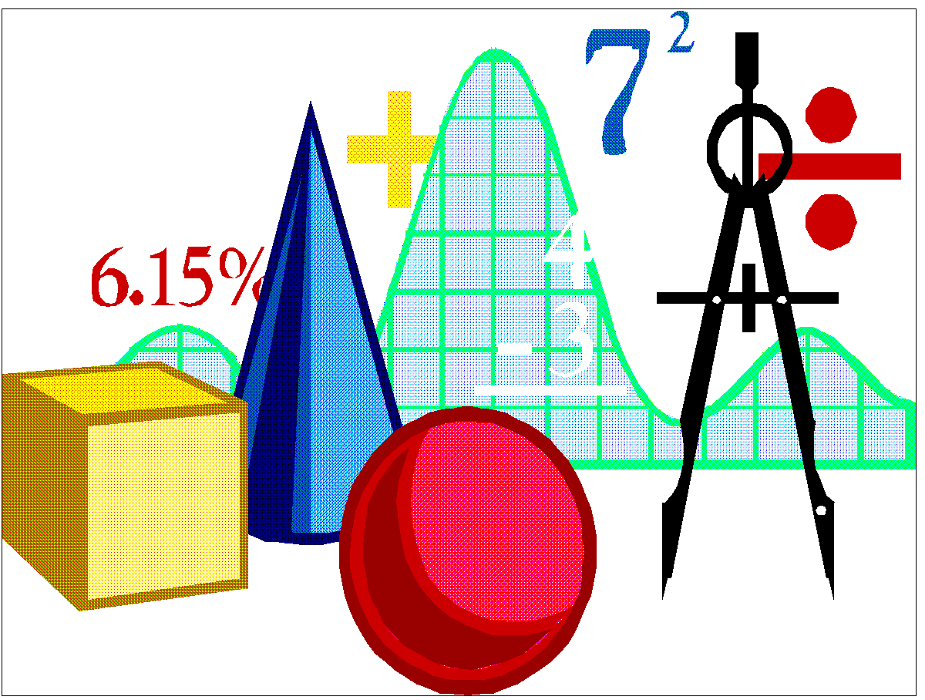
Mathematics

Slide 27
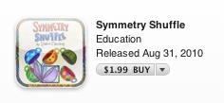
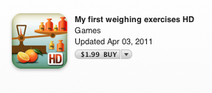
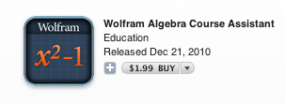

Slide 28
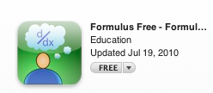
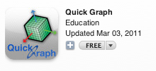

Slide 29
Social Studies

Slide 30
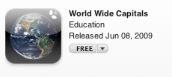

Slide 31
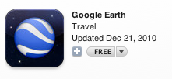
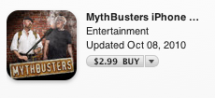
Other Great Apps for Teaching and Learning

Slide 32
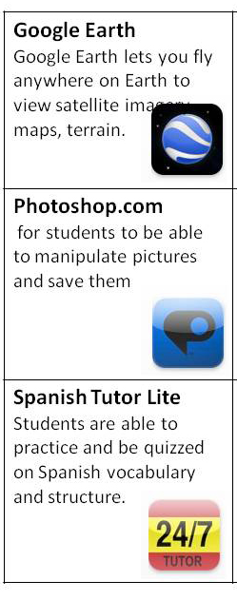
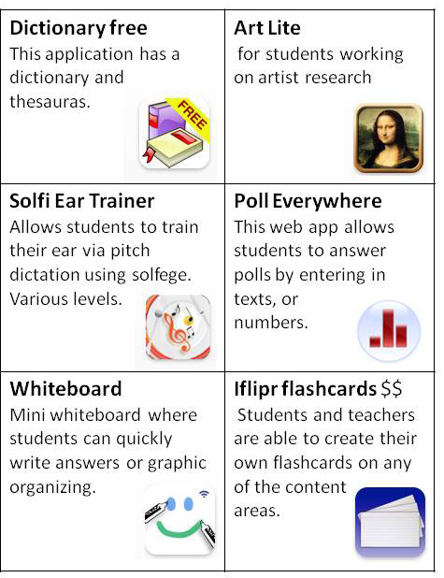
Source: http://sites.google.com/site/itunesandpodcasting/i-touch

Slide 33
How to Reach Me
Email: rblount@wcpss.net
Website: www.cte-rb.weebly.com

Slide 34
Notes:
Closing Slide
Some talking points to help you promote yourself and SDE as you close your presentation:
Tell which of these content areas you’d be happy to come back and provide more training around
SDE offers training in a variety of content areas
SDE offers a deep and broad variety of training options (seminars and conferences, online, onsite, and books/resources)

