Slide 1
Week 2
Connections and Troubleshooting

Slide 2
Your Instructors
Mr. Lile
Ms. Blount
Ms. Tiana
Mr. Marshall

Slide 3
Last week: Inside the Computer
The motherboard connects all the parts inside
The power supply sends electricity to the motherboard and the components
Each part needs power and data connections
Old computers and parts can often be refurbished, reused, or recycled

Slide 4
This week: Connections and Troubleshooting
You’ll learn about connecting input and output devices to a computer
You’ll learn troubleshooting, how to figure out and fix problems with computer hardware
You’ll refurbish computers that will be donated to other students as practice for refurbishing your own computer!

Slide 5
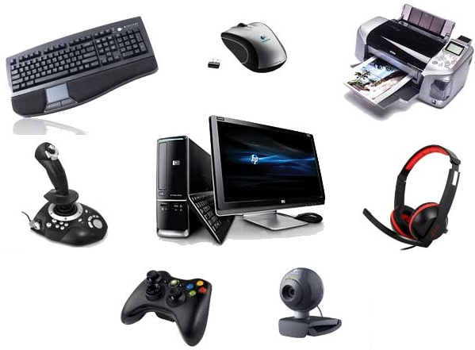
Peripherals
You can’t use a computer if you can’t give it commands and see what it’s doing.
Peripherals connect to a computer to let you use it
They are used for input and output

Slide 6
Peripherals
Input is giving commands or sending information to a computer
Output is what the computer sends back to you

Slide 7
Group the available peripherals as either Input or Output

Slide 8
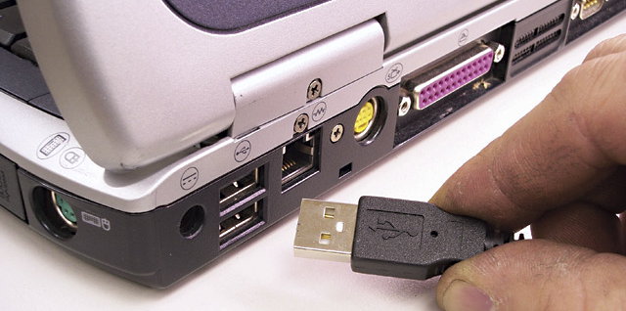
Attaching Peripherals
Peripherals have plugs or cables that connect to the computer
The connectors where the cables plug in are called ports
Cable with Plug
Ports

Slide 9
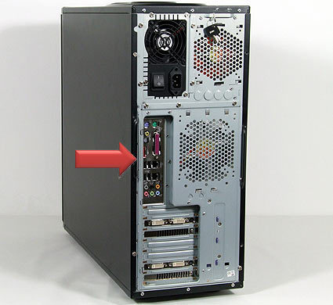
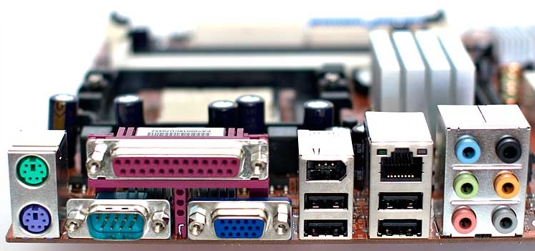
Motherboard I/O Panel
These are the most important connections. There will always be things plugged into the I/O Panel.

Slide 10
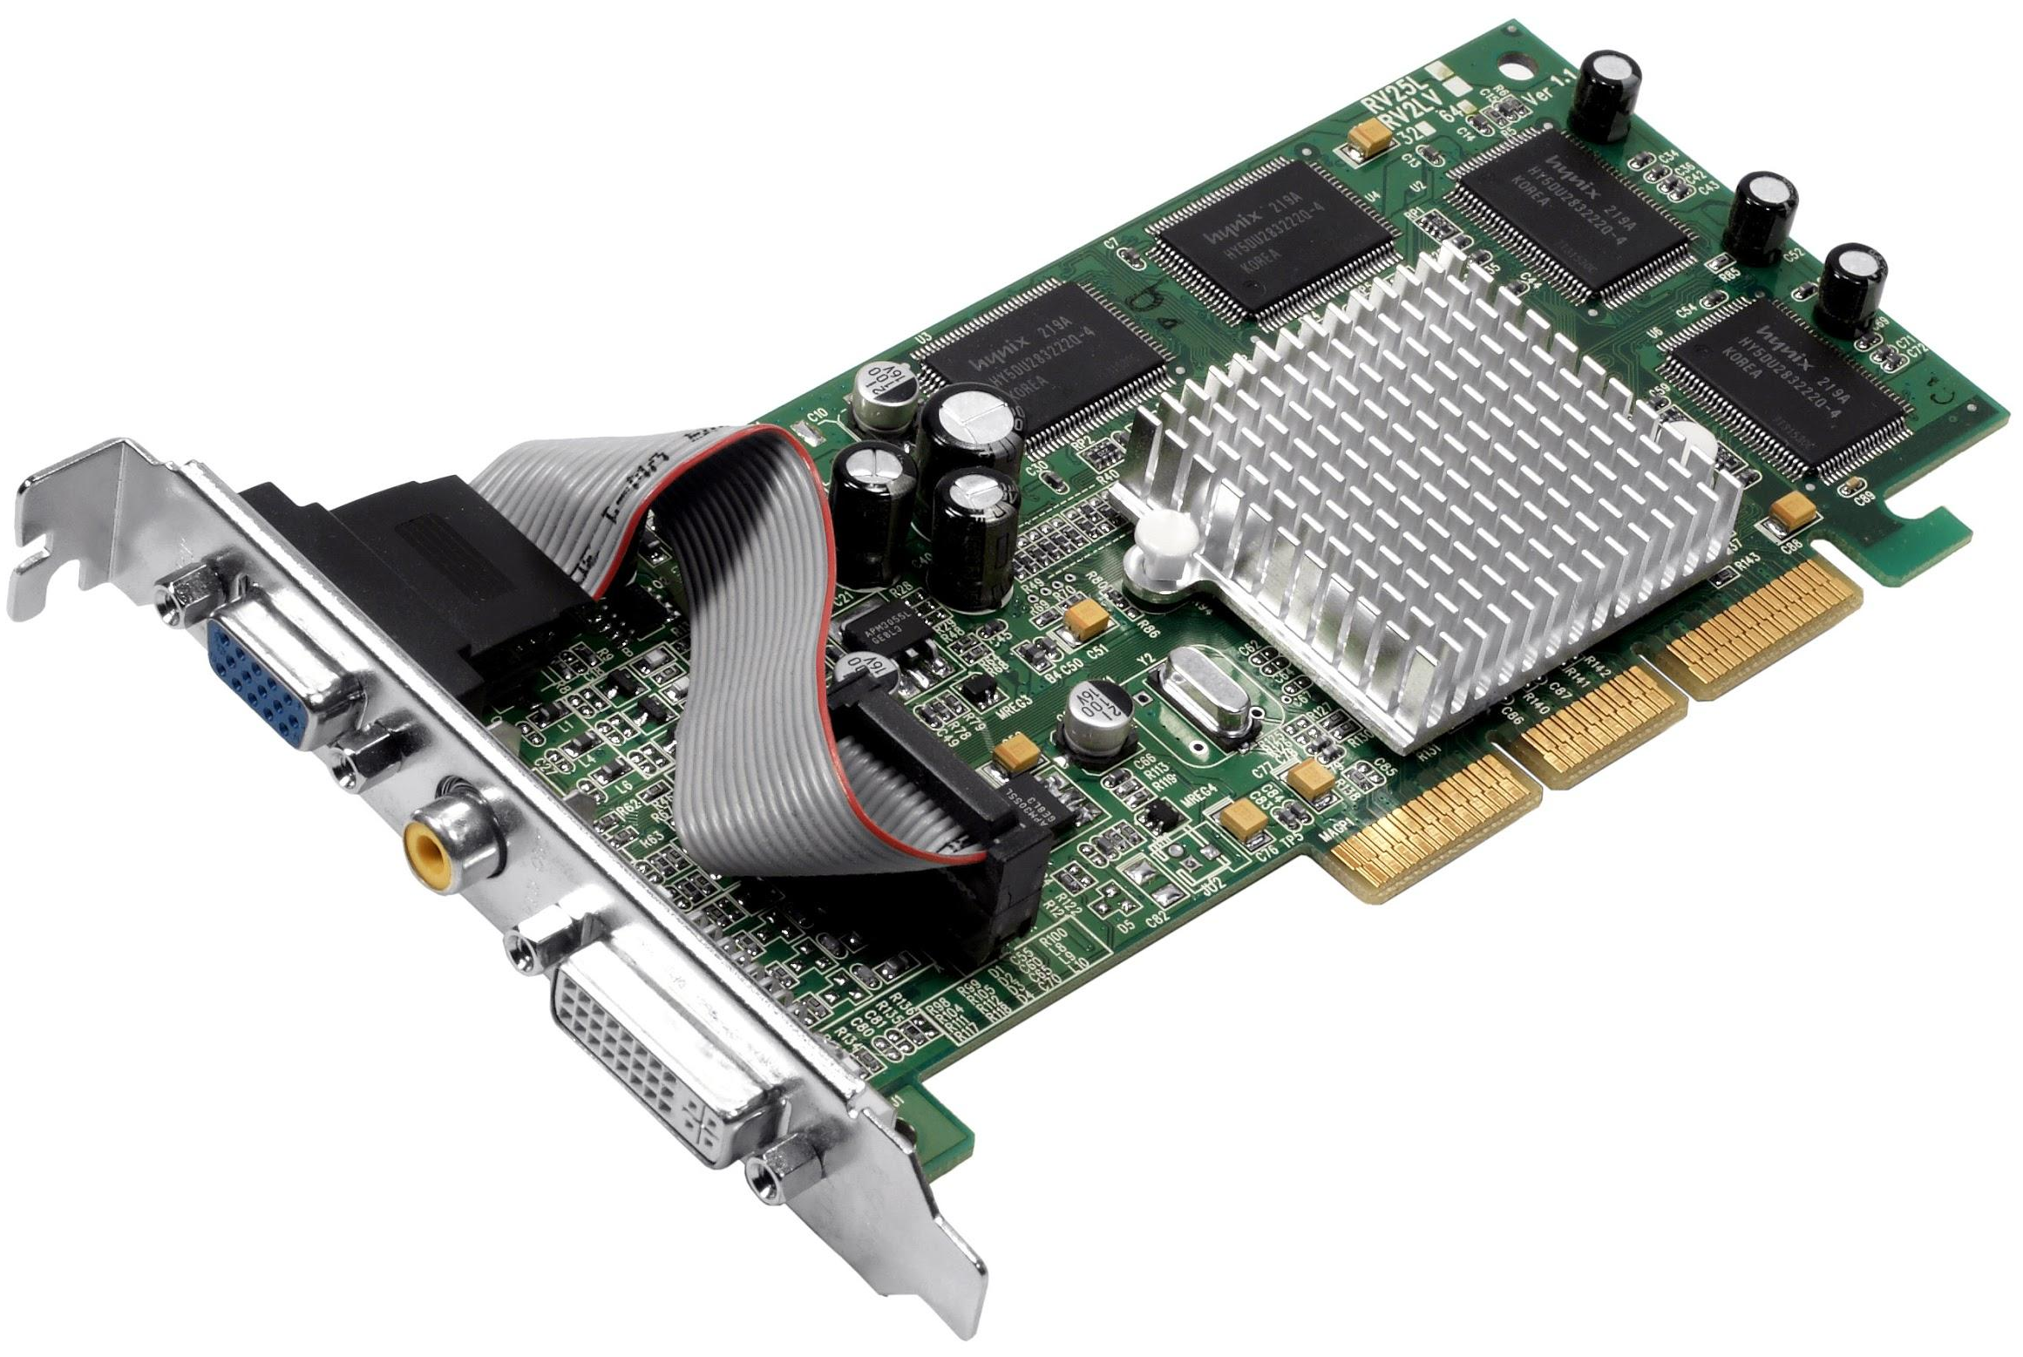
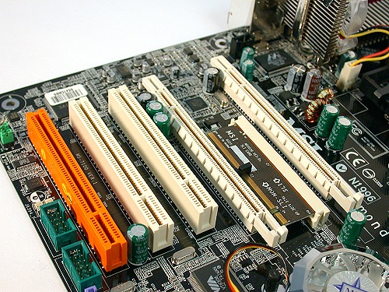
Expansion Card Slots
Expansion cards fit into connectors on the motherboard
Examples:
Graphics cards
WiFi cards
Sound cards

Slide 11
What peripherals would always be plugged into a computer?
What do you touch or look at every time you use a computer?

Slide 12
What peripherals would always be plugged into a computer?
Keyboard
Mouse
Monitor

Slide 13
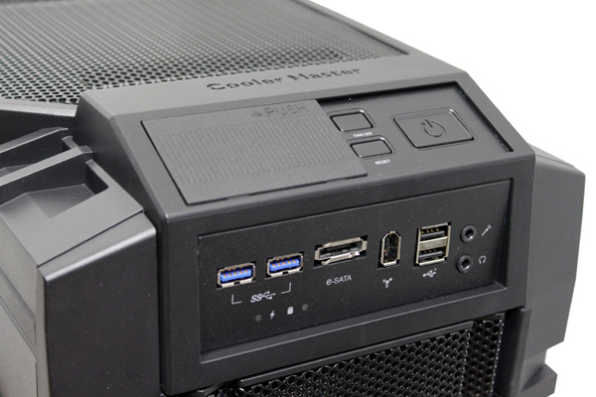
Front Panel Connections
Connections that are used a lot are put on the front, top, or side of the computer for easy access

Slide 14
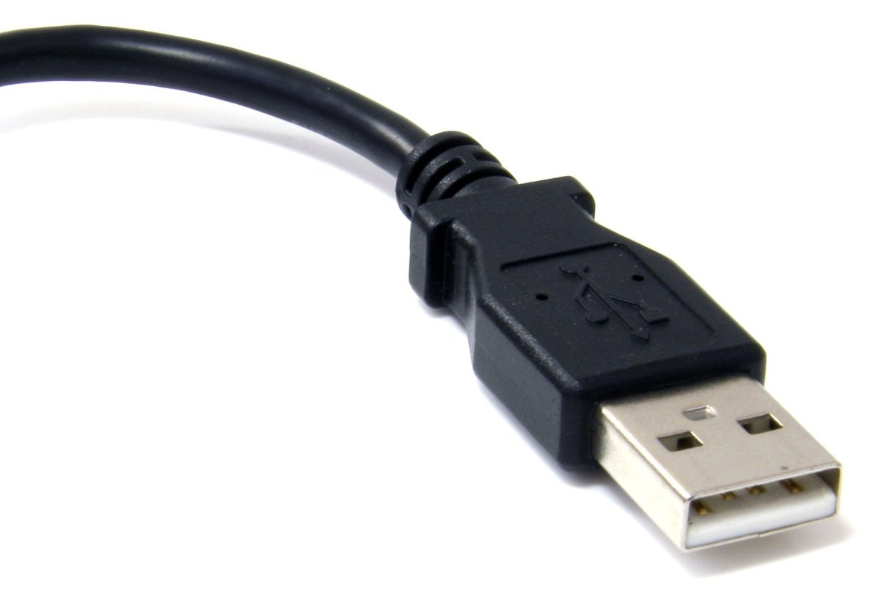
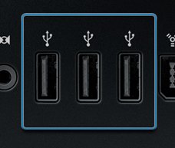
Types of Connections
Different peripherals use different connections
USB is the most common connector
USB is used for keyboards, mice, webcams, USB drives, printers, and more!

Slide 15
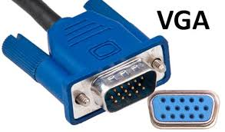
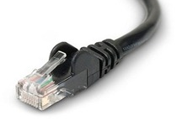
Types of Connections
VGA for monitors
Other monitor connectors: DVI HDMI DisplayPort
Audio 3.5mm plugs for headphones, speakers, and microphones
Ethernet for wired Internet

Slide 16
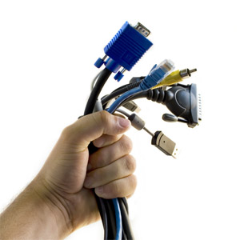
With your partner, take a set of cables back to your computer

Slide 17
Connections on a Dell Computer
On the back of the computer:
Power plug
Headphones/Speaker (colored green)
Microphone (colored pink and blue)
Why are they in different colors?
Color Coding helps you tell one connector from another, because some have the same shape!

Slide 18
Connections on a Dell Computer
On the back of the computer:
4 USB ports
2 more USB ports
Ethernet (network) port
Why can’t I plug this cable in?
Keyed connectors are shaped so that you can’t plug it in the wrong way. Turn the plug over and try again!
Key

Slide 19
Connections on a Dell Computer
On the back of the computer:
VGA port (blue)
Serial port (obsolete, green)
Parallel port (obsolete, magenta)
Why would I ever use this?
Obsolete connectors aren’t used much anymore. They’ve been replaced by newer and better ones.

Slide 20
Connections on a Dell Computer
On the back of the computer:
eSata (black)
DisplayPort (black)
Expansion slots
Has anything been added?
Expansion cards would be in these slots. The metal covers come off. Does yours have anything added?

Slide 21
Connections on a Dell Computer
On the front of the computer:
2 USB
Headphones and Microphone
Aren’t these the same thing?
Duplicate ports are on both the front and the back. You can plug different things in each duplicated port.

Slide 22
Power ON your computer by pressing or holding the button

Slide 23
Troubleshooting
You will run into problems when building or repairing a computer.
That’s OK! Computers are complex, so a lot can go wrong.

Slide 24
Troubleshooting
Find a problem? Use these steps to figure out what’s causing it and fix it!
Describe the problem clearly: When did it start? What changed before it happened?
Identify possible causes
Process of elimination: One by one, try solutions to possible causes
Test the Solution: Repeat steps 3 and 4 until fixed!

Slide 25
Power OFF your computer by pressing or holding the button
DO NOT open it up, yet!

Slide 26
Safety
Always unplug the computer from the power outlet before working on it
Don’t touch anything inside the computer while it is plugged in or turned on

Slide 27
Refurbishing a Computer
Refurbishing means you take a used computer and make it as good as new. This week we’ll refurbish the hardware of a computer.
Each stage of the refurbishing process must be recorded on Kramden’s tracking sheet.

Slide 28
Kramden’s hardware refurbishing
is called Triage
Triage is a medical term for taking care of sick patients. You’re like a doctor doing surgery to make a patient better!

Slide 29
Detailed Triage Steps
T1. Inspect the outside of the computer for any obvious problems or repairs
T2. Blow out dust (already done for you)
T3. Attach a tracking sheet and K-number sticker. Write this K-number on the back of the computer (in Sharpie) and on the tracking sheet
T4. Inspect/Repair the outside if possible

Slide 30
Detailed Triage Steps, part 2
T5. Inspect/repair the inside: Install 2GB of RAM (1 or 2 sticks), a hard drive,
and an optical drive. Connect ALL cables!
T6. Boot to BIOS: First, check that all fans work. Set the date & time and boot order. At the top of the tracking sheet, record the specifications:
processor speed, RAM/memory, & hard drive size

Slide 31
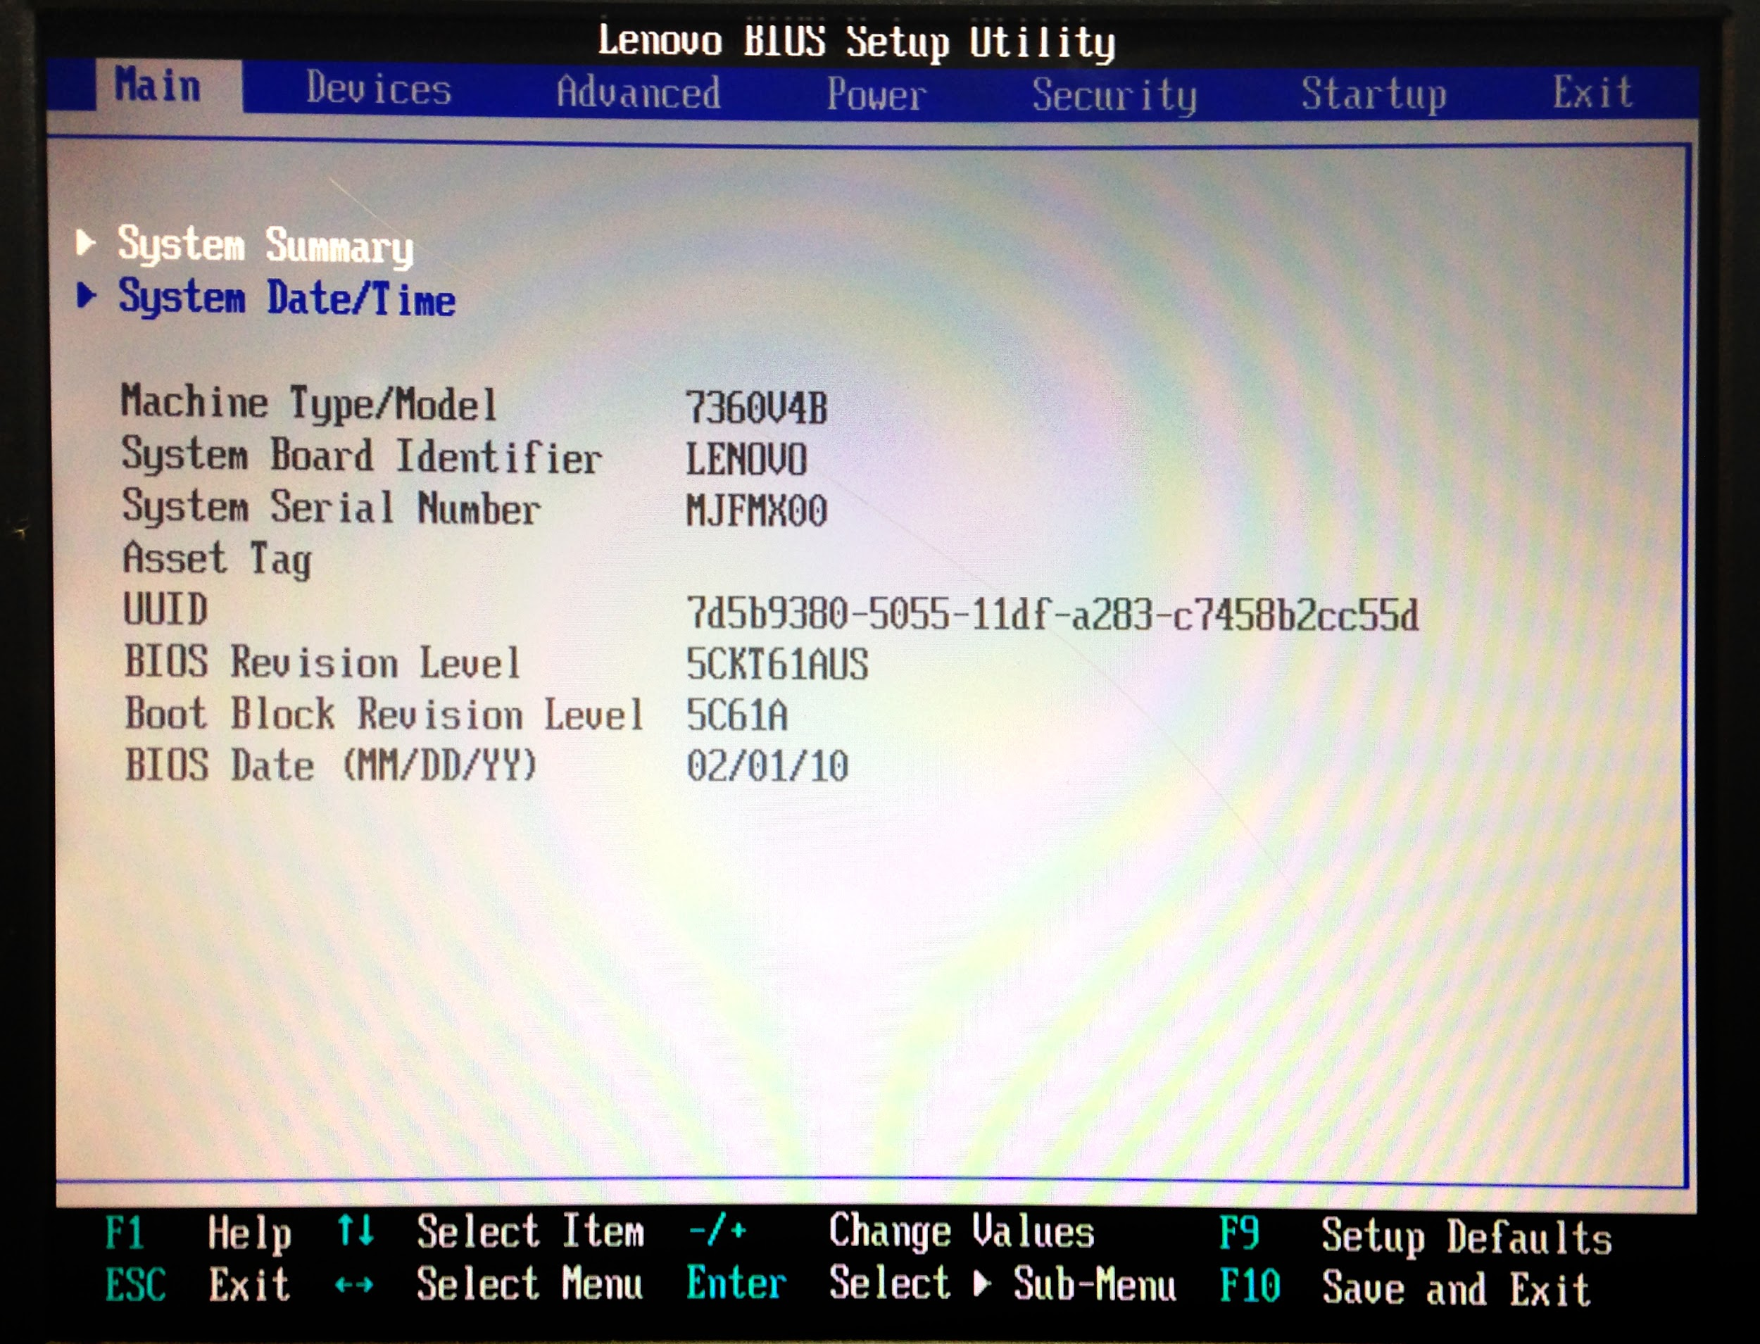
The BIOS screen
Menu headings
Current screen
Controls/Help
screen

Slide 32
Detailed Triage Steps, part 3
T7. Boot from the Kramden Triage CD and run
MEMTEST to test the RAM/Memory sticks. After
Test #3 is completed, reboot.
T8. Boot from the Kramden Triage CD and run
GWSCAN to test the hard drive. Select Quick Test
Follow the on screen instructions.
T9. Remove the Triage CD and power off!!

Slide 33
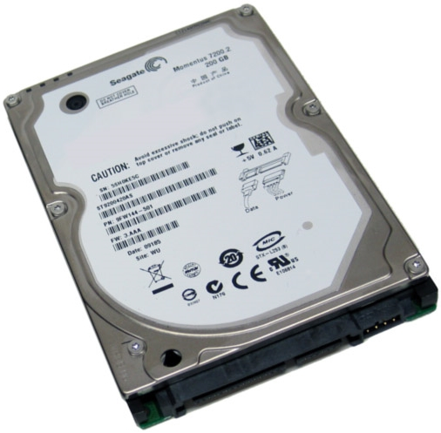
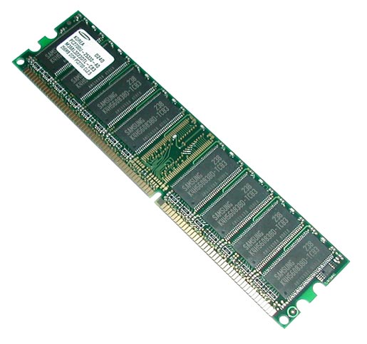
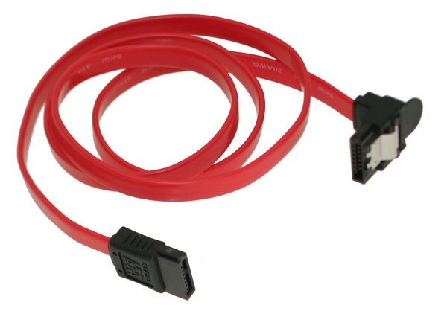
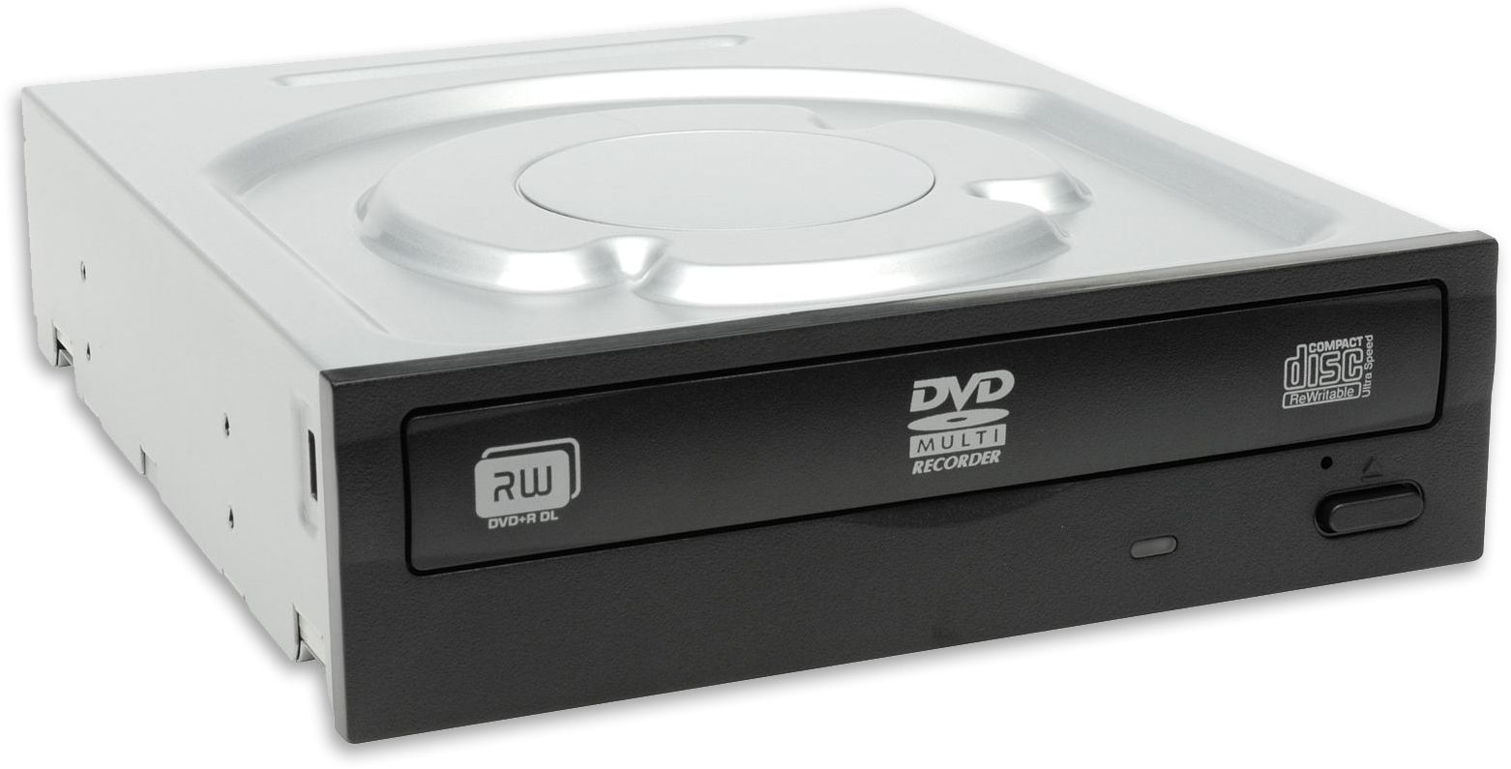
Finish the Triage process on your first computer! When you’re ready, start another one!

Slide 34
Troubleshooting
Troubleshooting is the most basic thing that a computer technician or engineer does.
Even the most experienced PC technician gets stumped. You learn through experience and get better and faster at troubleshooting.
Each time you solve a problem, think about the cause and solution so you remember it when it happens again.

Slide 35
Workshop: Putting Together a Computer
Let’s take a quick break and then head into the workshop area to put together computers and test the parts.

