Slide 1
Week 5
Build Your Own Computer

Slide 2
Your Instructors
Mr. Lile
Mr. Bill
Mr. Marshall

Slide 3
Class Photo
Say cheese!

Slide 4
Funded by the Cisco Foundation
Cisco provided support to Kramden so you could take this class and get a computer for free. Cisco makes network hardware and software.

Slide 5
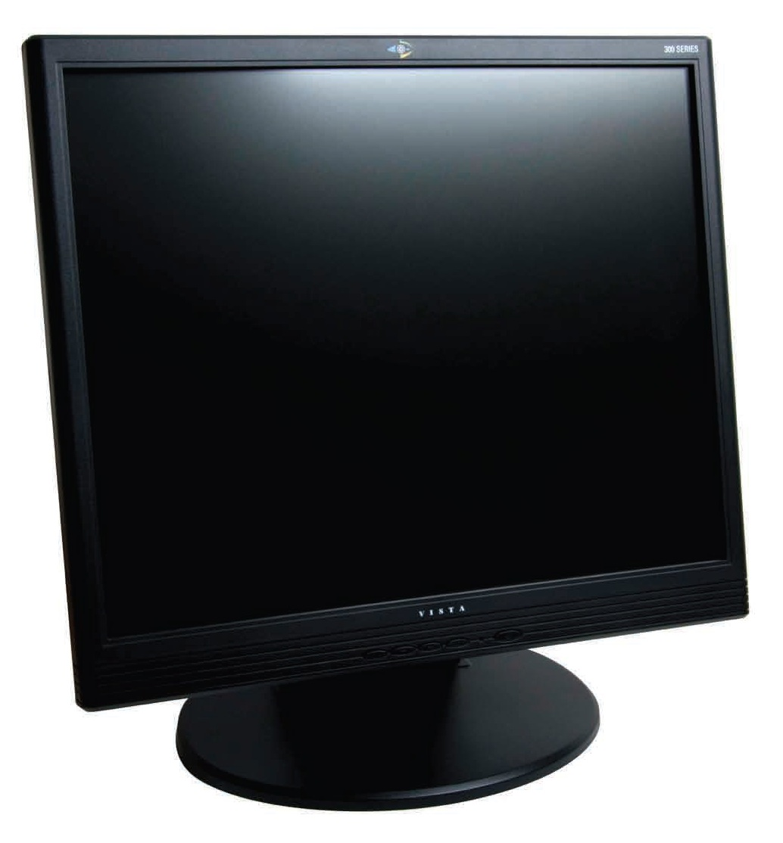
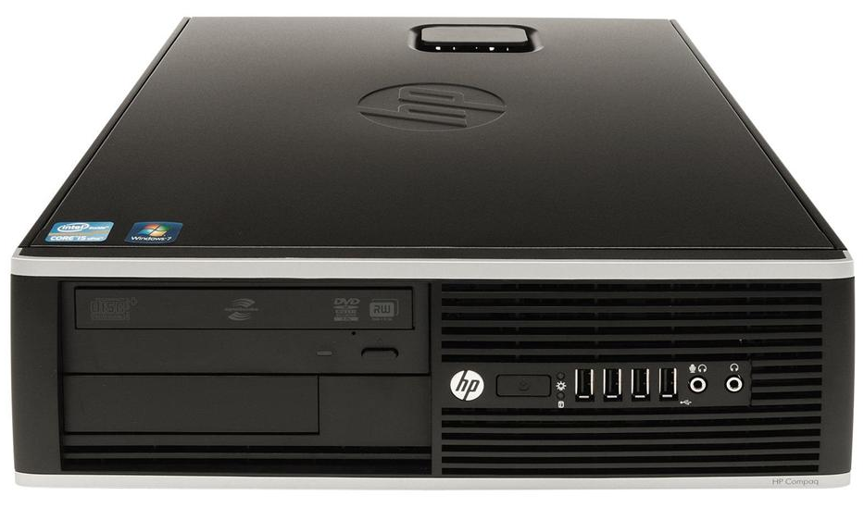
This week: Build your own computer!
Today you’re going to use everything you’ve learned to fix up your own computer to take home!

Slide 6
Let’s review what you learned!
We covered four big topics in class:
Hardware Components: The parts inside the computer
Peripherals and Connections: Connecting input and output devices to a computer
Software: The operating system (OS) and programs
Networks: Computers connected to each other and the Internet

Slide 7
We’re going to play a quiz game
On your smartphone or one of our laptops, go to
the website kahoot.it

Slide 8
Workshop: Triage, OS Load, and Final Test
Let’s take a quick break and then head into the workshop area to refurbish more computers, load the Ubermix OS, and test them.

Slide 9
Hardware: Inside the Computer
Computers are digital devices that use electronic components to do calculations.
Computers are all around us and come in many shapes and sizes
Components are the parts inside a computer
Every component needs a power connection to turn on and a data connections to talk to the other parts
Old computers and parts can often be refurbished or reused. Otherwise they should be recycled, not thrown away.

Slide 10
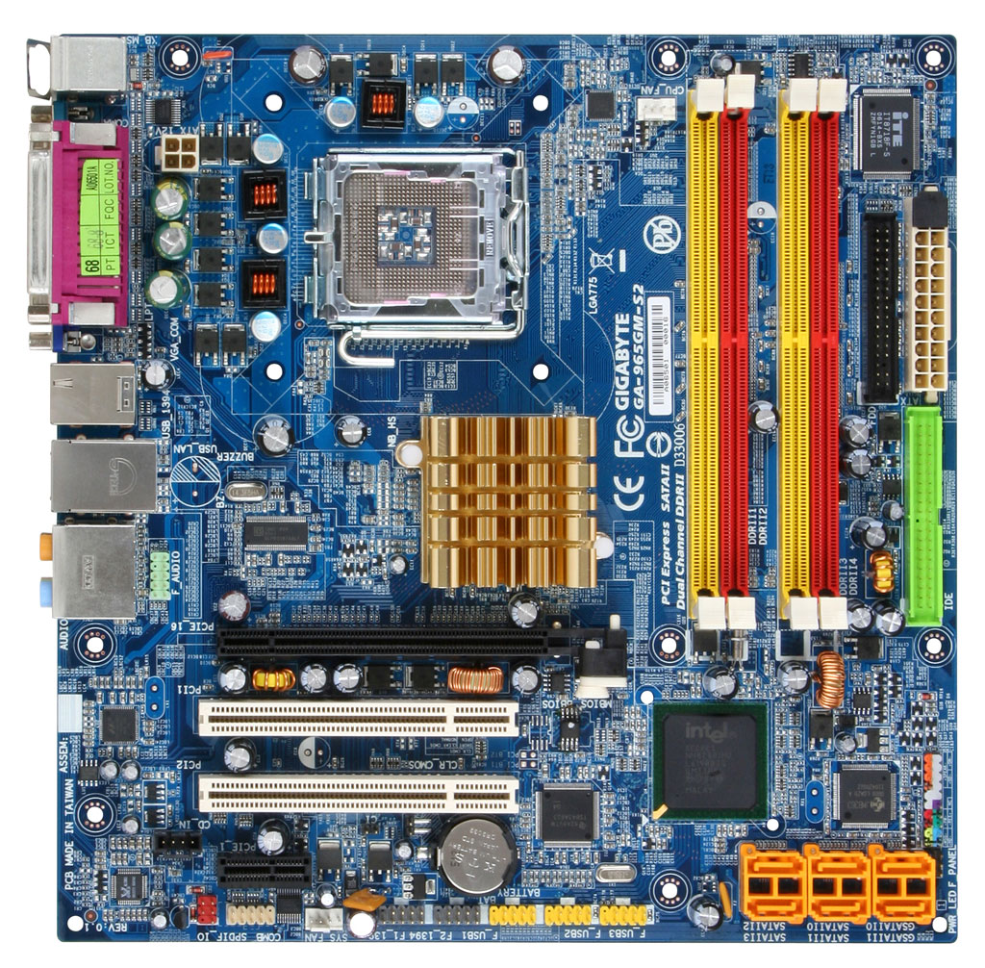
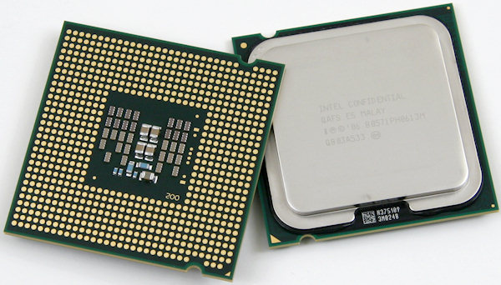
Computer Parts (Components)
The motherboard connects all the other parts
The power supply sends electricity to the motherboard and the components
The CPU or processor does all the computer’s thinking

Slide 11
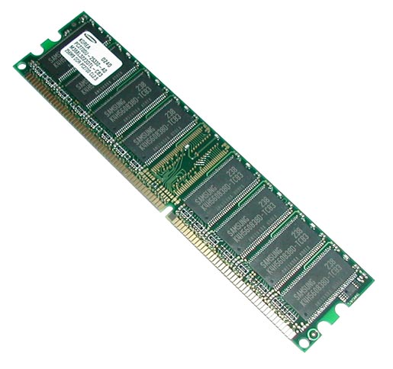
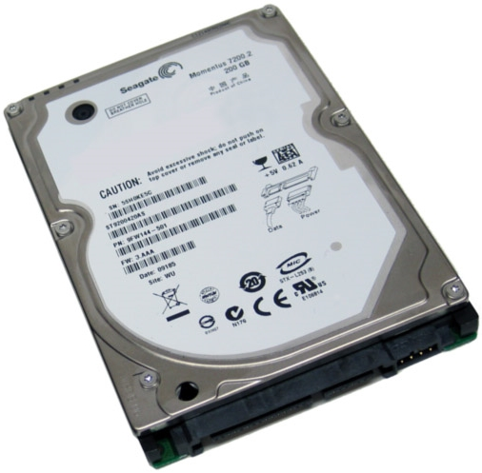
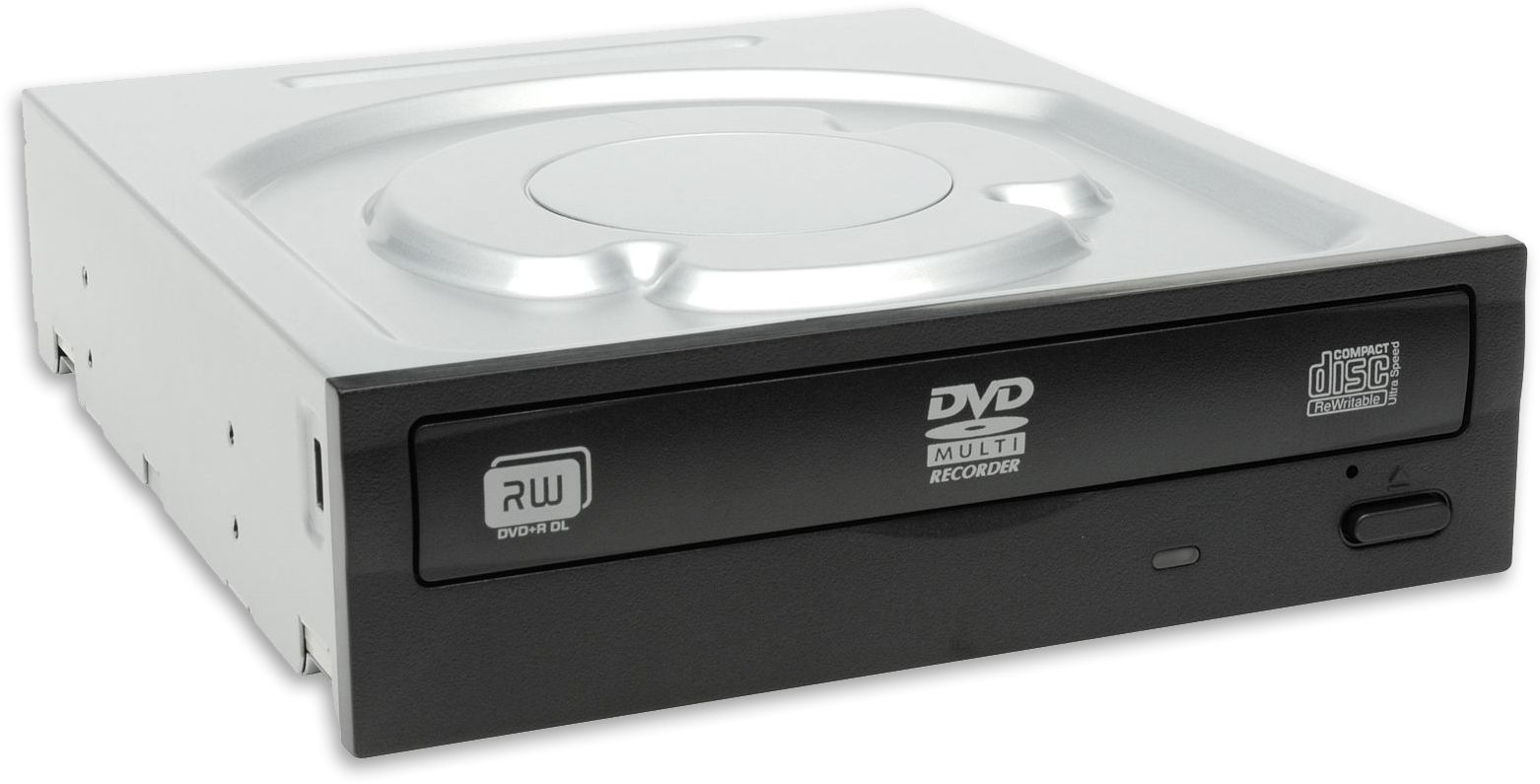
Computer Parts (Components)
RAM is temporary memory that holds your running programs and files
The hard drive stores the operating system, programs, and your files
The optical drive lets you use CDs and DVDs

Slide 12
Hardware: Peripherals and Connections
Peripherals connect to a computer and provide input and output
Input devices let you give commands or send information
Output devices lets the computer show you information
Peripherals plug into particular ports on the computer

Slide 13
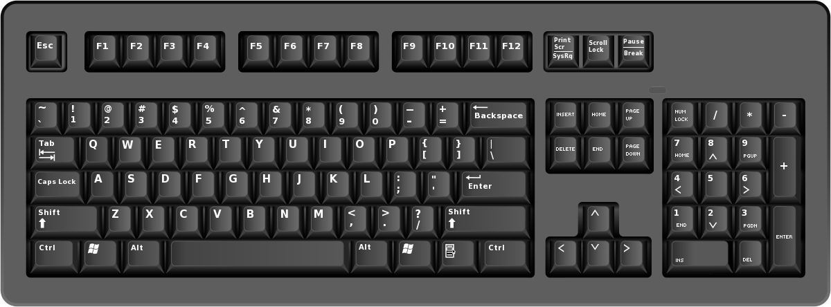
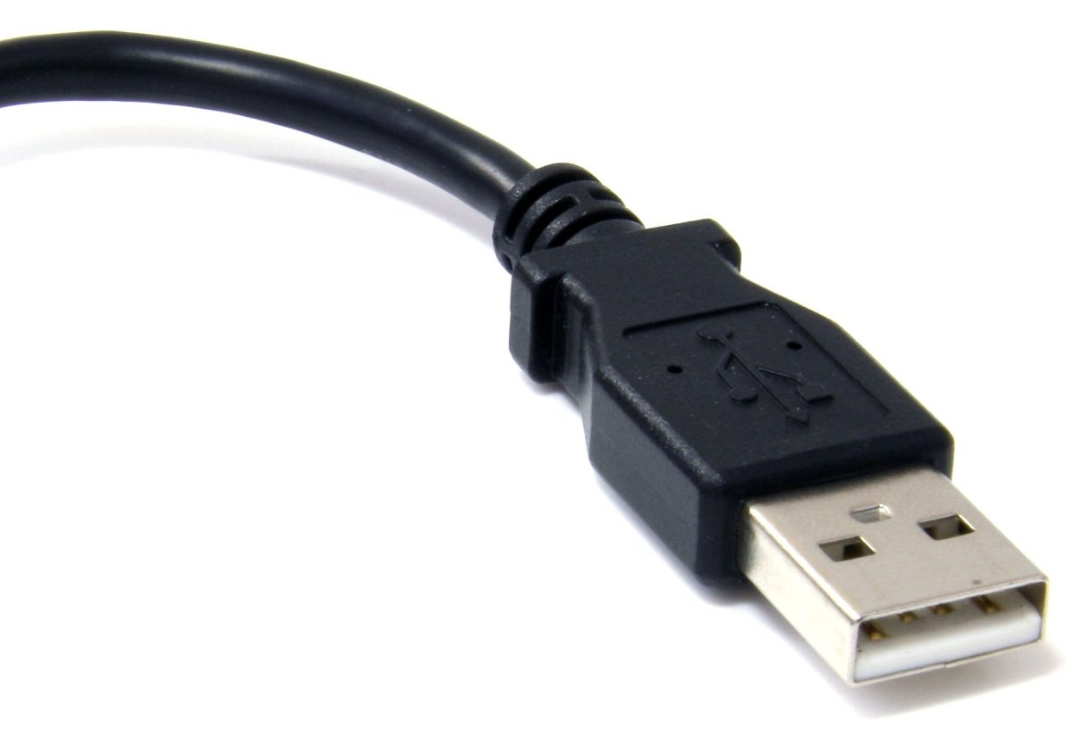
Peripherals
Input peripherals include the keyboard, mouse, and microphone
Output peripherals include the monitor, printer, and speakers
USB is the most common connection type for peripherals

Slide 14
Software
All computers think in binary, or ones and zeroes
Computers encode and decode data into binary digits, or bits, to process and store it
Software includes operating systems and programs
There are many different operating systems
The BIOS is a tiny OS that lets you change basic settings on a computer.

Slide 15
About Ubermix
Ubermix is a version of Ubuntu (Linux).
It’s easy to use and runs fast on refurbished computers.
It doesn’t get viruses or other bad programs.

Slide 16
About Ubermix
It comes with 60 programs, including programs for schoolwork, Web browsers, games, and more.
All the programs are in categories at the bottom of the screen
LibreOffice is for word processing, presentations, and spreadsheets

Slide 17
Get the Right Programs
Programs have to be run on the right OS. They won’t work on a different OS unless the programmer has written a different version.
It’s like Xbox and Playstation games. An Xbox game won’t run on a Playstation. Sometimes the same game is on both, but you still can’t use the Xbox disc in the Playstation.
If you need to add a program to Ubermix, look for ones that say they work on Ubuntu or Linux.
Use the Ubuntu Software Center to get programs easily.

Slide 18
Adding Programs to Ubermix
Use the Ubuntu Software Center program to get more programs
It’s like an app store
Most programs are free

Slide 19
Add a Program
Search for “SpeedCrunch” in Ubuntu Software Center - it’s a calculator that can help you with homework.
Find the program in the list
Click More Info, then click Install
Look under Accessories to open it

Slide 20
Programs that use the Internet
Some programs won’t work unless you computer is connected to the Internet:
Firefox and Chrome - Web browsers
Dictionary
Google Earth

Slide 21
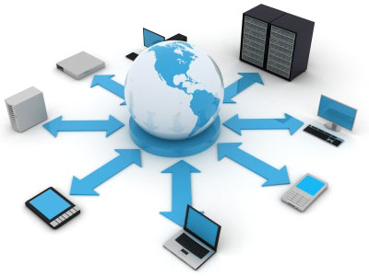
Networks
A network is computers that are connected to each other.
Ethernet cables connect computers to a network.
Wifi, or wireless networking, uses radio waves instead of Ethernet cables
The Internet is a network of computers around the world.

Slide 22
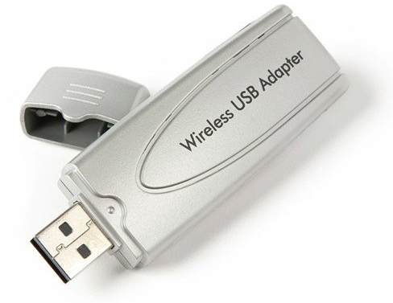
Using Wifi (Wireless Internet)
Once you have Internet service and a modem and router at home, you can set up a wireless network.
A wireless network uses radio waves instead of cables to connect computers to the Internet.
Your computer has to have a wireless adapter to use Wifi.
All laptops, smartphones, and tablets have this built in.
Desktops need a USB adapter that stays plugged in all the time.

Slide 23
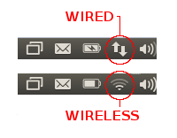
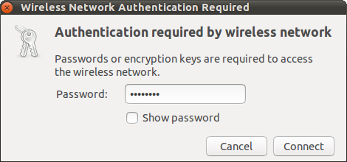
Check your Internet connection in the Status Bar
For Wifi, choose your home wireless network from the list.
Type your password and click Connect.

Slide 24
Fixing up a Computer
Kramden Institute uses a 4-step process to fix up, or refurbish, computers.
Triage: Install parts in a computer and test them
Cleaning: Remove stickers and dust
OS Load: Install the UberMix operating system
Final Test: Check everything one last time
By the end of class today you will have completely refurbished at least 5 computers, including your own!

Slide 25
Safety
Always unplug the computer from the power outlet before working on it
Don’t touch anything inside the computer while it is plugged in or turned on
Follow the instructions provided for each step

Slide 26
Troubleshooting
Find a problem? Use these steps to figure out what’s causing it and fix it!
Describe the problem clearly: When did it start? What changed before it happened?
Identify possible causes
Process of elimination: One by one, try solutions to possible causes
Test the Solution: Repeat steps 3 and 4 until fixed!

Slide 27
Troubleshooting
Troubleshooting is the most basic thing that a computer technician or engineer does.
Even the most experienced PC technician gets stumped. You learn through experience and get better and faster at troubleshooting.
Each time you solve a problem, think about the cause and solution so you remember it when it happens again.

Slide 28
Class Photo with computers
Say cheese!

Slide 29
Fill out the Survey

Slide 30
Fill out the Equipment Receipt

Slide 31
Get your Handouts and Take-Home Form

Slide 32
Get your computer and all its parts!
Before you leave, make sure you have:
Your computer
Monitor and VGA cable
Mouse, Keyboard, 2 power cables, Wifi adapter
Class Handouts and Take-home form

Slide 34
What’s the difference between a job and a career?
Your job is your current employment.
Your career is the path of jobs you take in your lifetime.

Slide 35
Fixing up a Computer: Kramden’s Steps
Kramden Institute uses a 4-step process to fix up, or refurbish, computers.
Triage: Install parts in a computer and test them
Cleaning: Remove stickers and dust
OS Load: Install the UberMix operating system
Final Test: Check everything one last time
In class you have completely refurbished at least 5 computers, including your own! You used a technique called Troubleshooting to find solutions to hardware and software problems you ran into.

Slide 36
Troubleshooting
You will run into problems when building or repairing a computer. That’s OK! Computers are complex, so a lot can go wrong.
Ran into a problem? Use these steps to figure out what’s causing it and fix it!
Describe the problem clearly: When did it start? What changed before it happened?
Identify possible causes
Process of elimination: One by one, try solutions to possible causes
Test the solution: Repeat steps 3 and 4 until fixed!
Each time you solve a problem, think about the cause and solution so you remember it when it happens again.

